Slide 1

Editing BioCyc Databases Using the BioCyc Web Curation Server
By Suzanne Paley
paley@ai.sri.com

Slide 2
Desktop vs Web-based tools for PGDBs
PGDB Creation is via PathoLogic, which currently only runs as a desktop-based application
  This includes various manual refinement tools, which may group many changes of a similar type together.
PGDB Navigator can run as either desktop or web application (BioCyc.org or local server)
PGDB Editors support editing of individual data objects via either desktop or web (BioCyc curation server)
PGDB Maintenance and other tasks currently only available through the desktop application
  Consistency checking
  Upgrading for new versions of MetaCyc
  Bulk imports (e.g. gene essentiality or phenotype microarray data)

Slide 3
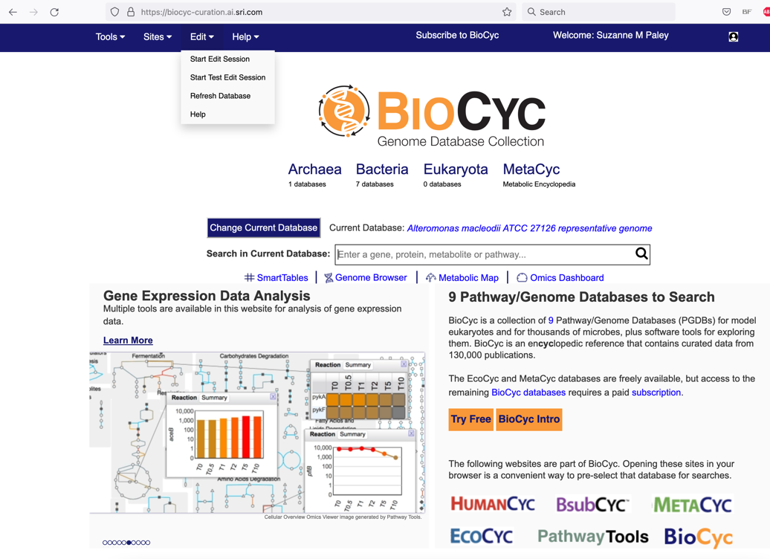
The BioCyc Curation Server
The BioCyc curation server is available at https://biocyc-curation.ai.sri.com
Contains only PGDBs under active curation
Only preauthorized users can edit
  To apply for access, email biocyc-support@ai.sri.com.
Log in using the same account you use to access BioCyc.org.
  If you have trouble logging in, try clearing your cookies or opening an incognito browser session
Authorized editors should see an additional Edit menu

Slide 4
Edit Sessions
All edit operations must take place within the context of an edit session.
A limited number of concurrent edit sessions are supported
  If you get a message that an edit session could not be started, try again later or email paley@ai.sri.com
A test edit session is the same as a regular edit session, except that changes will not be saved and will be discarded when session is ended. It is useful for training or testing purposes
When you have finished editing, please end your edit session
  Edit sessions automatically time out after 30 minutes of inactivity, or if server becomes unresponsive
  If your session is ended unexpectedly, just start a new one
An active edit session is indicated by an orange box in upper left hand corner of page

Slide 5
Edit menu contains
  Commands to create a new object, e.g. compound, reaction, pathway
  General non-page-specific commands, e.g. end session, open developer panel or ontology editor
Edit section in Operations menu contains commands related to objects on current page
Most editors will open in new tab

Slide 6

Bug reports
The web-based editors on the BioCyc curation server are beta software and may still contain bugs.
If you encounter problems, send email to paley@ai.sri.com.
Please indicate exactly what change you are trying to make, and what the problem is. Screenshots help, where applicable.
If you have not yet saved your changes, please do not do so, as this will give me a better likelihood of being able to reproduce the problem.

Slide 7


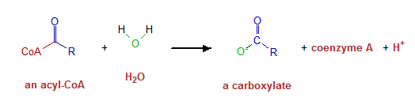
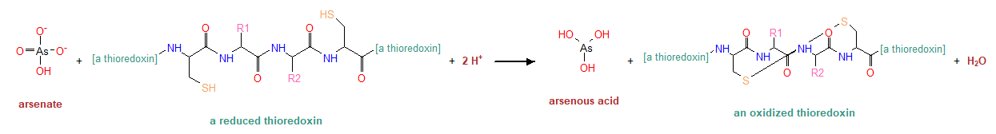
Classes and instances are like folders and files
Instances describe specific objects (e.g. L-lysine)
Classes describe groups of biological objects (e.g. “an amino acid”)
Classes can contain other objects, while instances can’t
Every compound
with an “R” in its structure
should be a class
Proteins or modified proteins that are substrates of MetaCyc reactions are always classes

Slide 8

What’s a frame? And why does it need an ID?
Every object in the database is a “frame”, and each frame has a unique ID within the database. Instance frame IDs are usually assigned automatically and are not very meaningful.
Examples: CPD-23, PWYQT-7, RXN0-555 MONOMER-387 CPLXI-345.
The prefix describes the type of object. Frame names generated in a PGDB other than MetaCyc include one or two characters that identify the source database.
Legacy objects in Pathway Tools (created before current naming standards) usually deviate from these guidelines.
Class frame names are usually created by humans and use language. E.g. Thioglucosides, Amino-Acid-Biosynthesis.
Object names include common names and synonyms. They are useful for both humans and computer searches. Unlike frame IDs, names may be not unique.

Slide 9
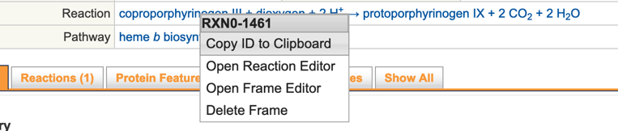

How to find the frame ID for an object
Curation sometimes involves working with frame IDs. There are multiple ways to determine the frame ID for an object
From the page URL:
  https://biocyc-curation.ai.sri.com/gene?orgid=GCF_000172635&id=MASE_RS00140
  https://biocyc-curation.ai.sri.com/GCF_000172635/NEW-IMAGE?type=REACTION&object=RXN0-1461
Displayed in tooltip
In an edit session, right-click on object link, use command to copy to clipboard
If not in an edit session, Ctrl-right-click to show id in persistent tooltip. Can use mouse to select and copy to clipboard

Slide 10
What sort of objects are usually edited?
The following are just a few examples
metabolites
reactions
pathways
enzymes: (creating complexes, assigning to correct reactions)
regulatory information
transcription units

Slide 11

The Web Editors
Protein Editor
  Includes complexes, components, enzymatic activities, genes
Protein Subunit Structure Editor
RNA Editor
  Includes genes
Gene Editor
  For genes without products, e.g. pseudogenes
Site Editor
Isoform Editor
Compound Editor
Reaction Editor
Pathway Editor
Transcription Unit Editor
  Includes promoters, terminators, regulatory interactions, binding sites
Frame Editor
Ontology Editor

Slide 12
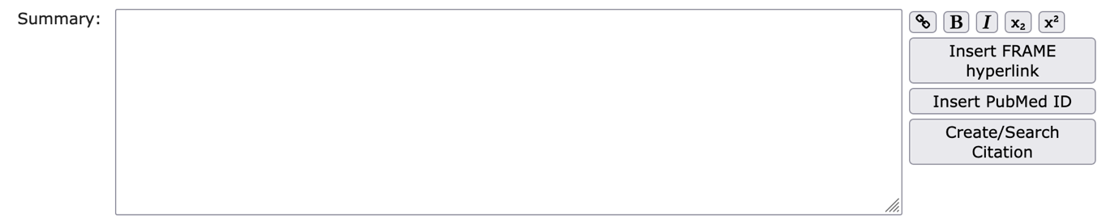
Writing Summaries
Most editors include one or more boxes to enter summary text. By writing summaries for enzymes and pathways you can turn your PGDB into a resource that integrates and summarizes the current knowledge about your organism.
Summaries should incorporate references to the literature, using the Insert PubMed ID or Create/Search Citation button.
Incorporating FRAME hyperlinks to other database objects is extremely useful. See for example https://biocyc.org/SYNWH8102/NEW-IMAGE?type=ENZYME&object=CPLX1YI0-83

Slide 13
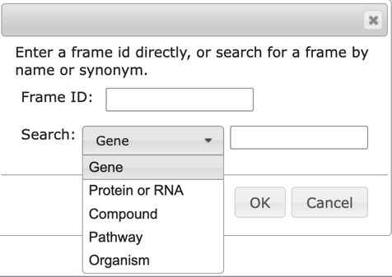
Adding Internal Hyperlinks
Enter internal hyperlinks via the Insert FRAME hyperlink button
Enter a frame ID, or search for objects of the selected type
This will insert a string of the form |FRAME: frame-ID| into the summary box. By default this will display as the frame common name
To modify what is shown in the summary, use this format |FRAME: frame-ID “type text here”|.
You can use hyperlinks to MetaCyc objects.

Slide 14
Example for a summary with hyperlinks
EC 2.7.2.4, aspartate kinase, catalyzes the committed step in the pathways that ultimately lead to the synthesis of the amino acids lysine, threonine and isoleucine.
|FRAME: EC-2.7.2.4|, catalyzes the committed step in the pathways that ultimately lead to the synthesis of the amino acids |FRAME: LYS|, |FRAME: THR| and |FRAME: ILE|.

Slide 15
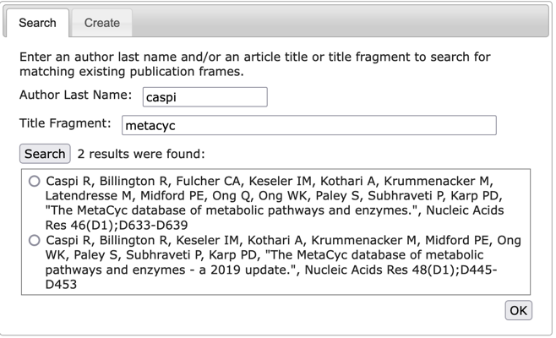
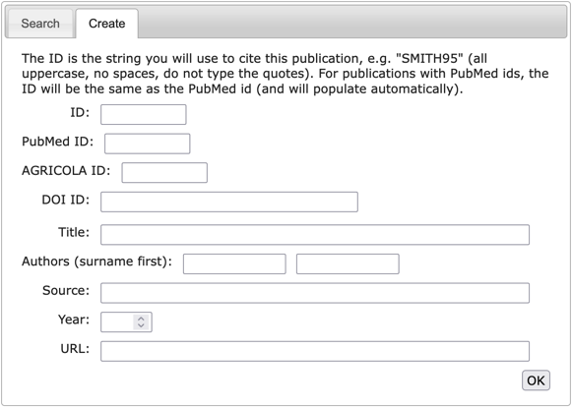
Adding Citations to Summaries
Insert PubMed ID button inserts |CITS: []| into the summary
Add PubMed ID inside square brackets, e.g. |CITS: [1234556]|
Alternatively use Create/Search Citation button
Search tab searches publications already in current db or in MetaCyc
Create tab creates a new publication entry
  If you supply a PubMed id, AGRICOLA id or DOI, other fields should fill in automatically
  For non-PubMed citations, you must supply an id

Slide 16
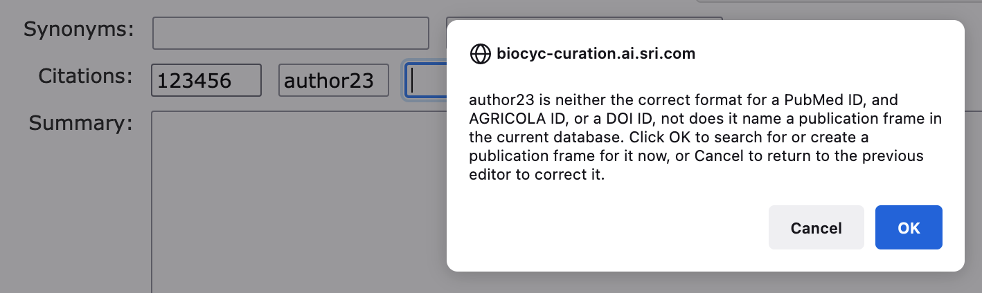
Adding Citations outside of summaries
Enter PubMed id into citation text field
If no PubMed id, enter some other unique id, e.g. authorYY
If no publication with that id exists yet in the database, you will be given the opportunity to search for or create it.

Slide 17
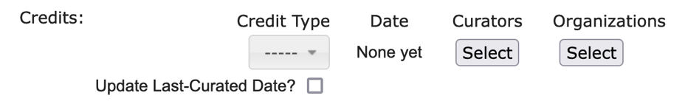
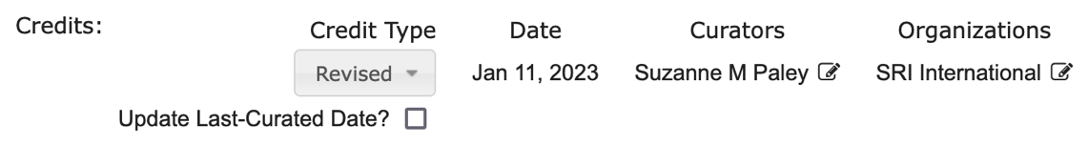
Author Credits
Author credit gives you credit for your work.
Associating objects with their author makes it easy to find the objects you worked on.
Author credit typically includes both individual curator and organization
  Organization objects cannot yet be created via the web editors
  If your organization is missing, let us know and we will add it.
Types of credit: created, reviewed, revised, last-curated
Many editors have sections at the bottom to specify credit
Once you specify credit type, other fields will fill in automatically (but you can change curator and organization)

Slide 18
Proteins, Genes, RNAs

Slide 19
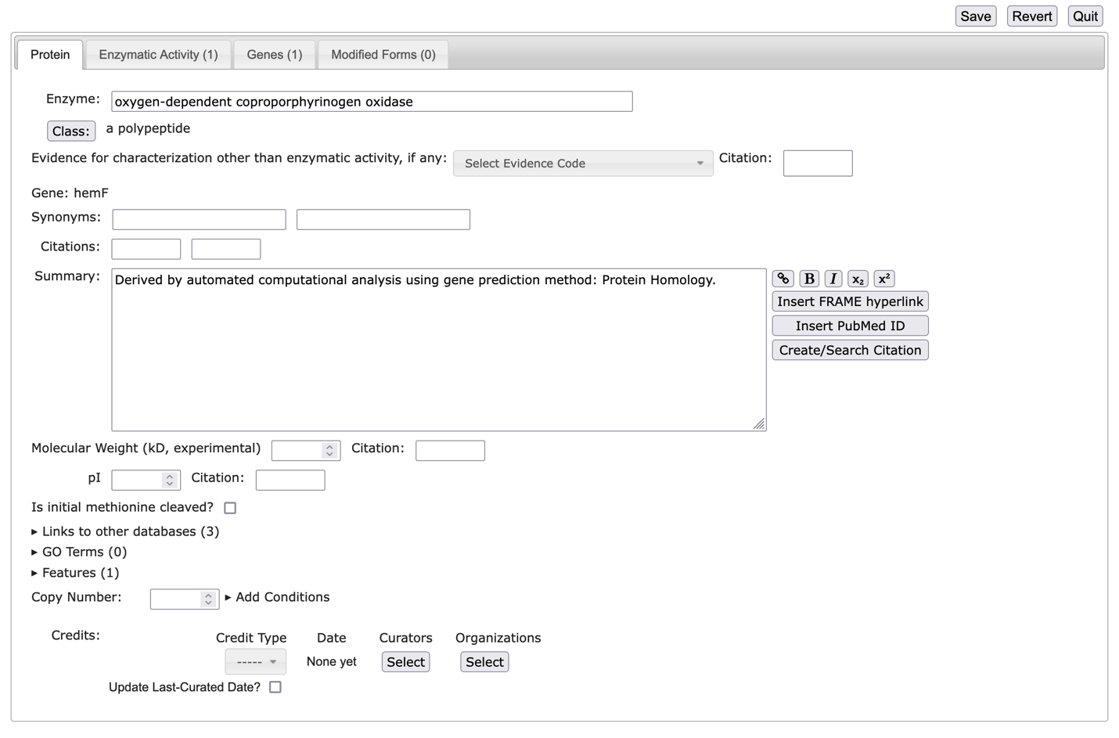
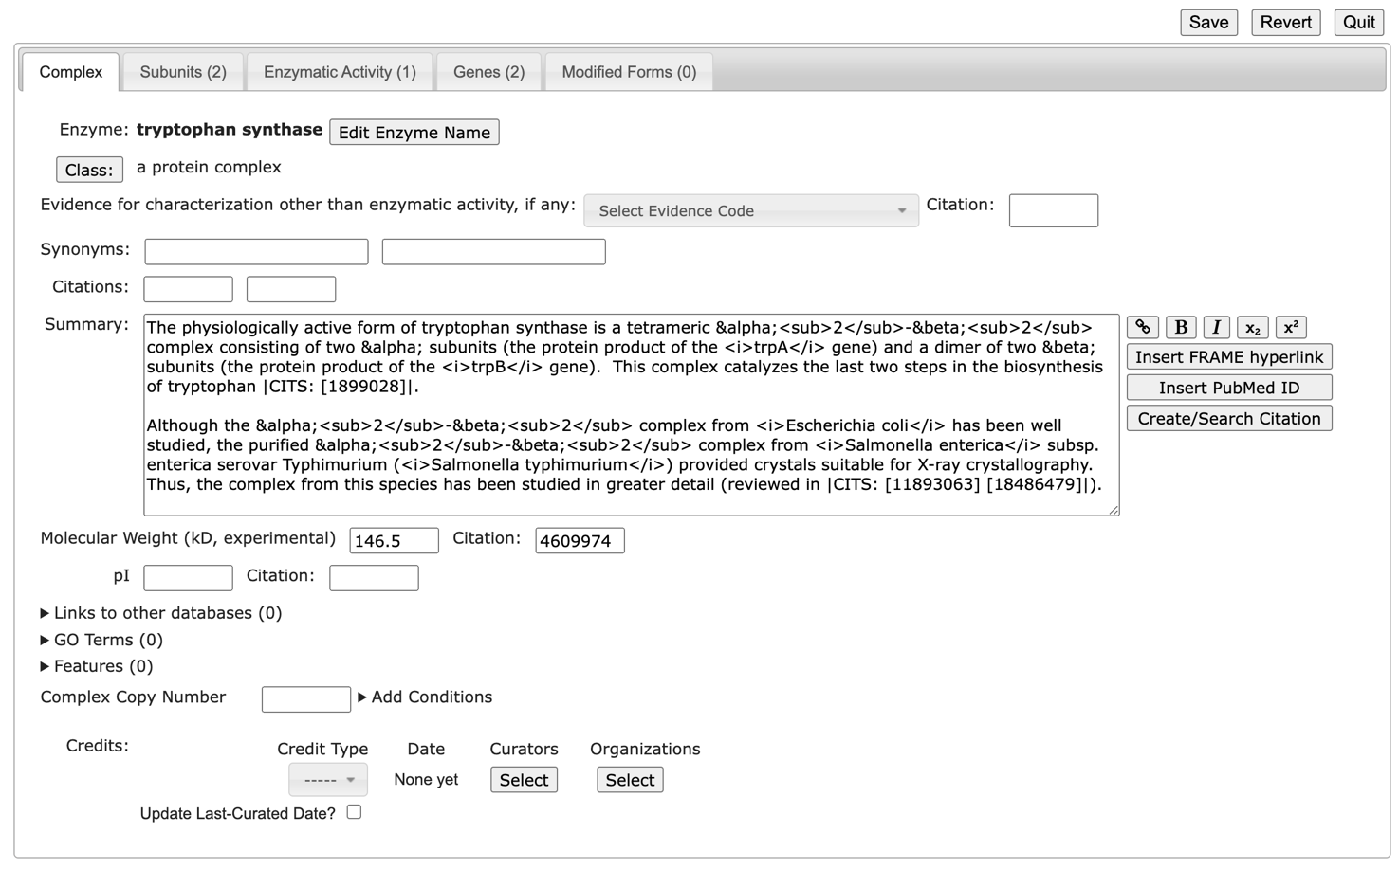
The protein editor
(monomer version)
(protein complex version)

Slide 20
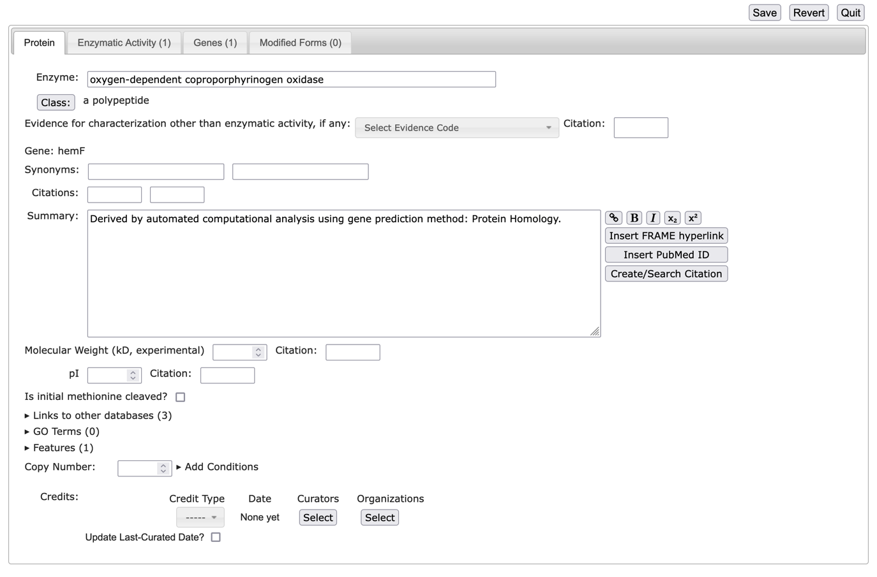
Protein Editor – first tab
Enzyme or protein name
Evidence code for non-enzyme proteins
links to other databases
experimental MW and any useful info that may apply (GO terms, features, copy number etc)

Slide 21
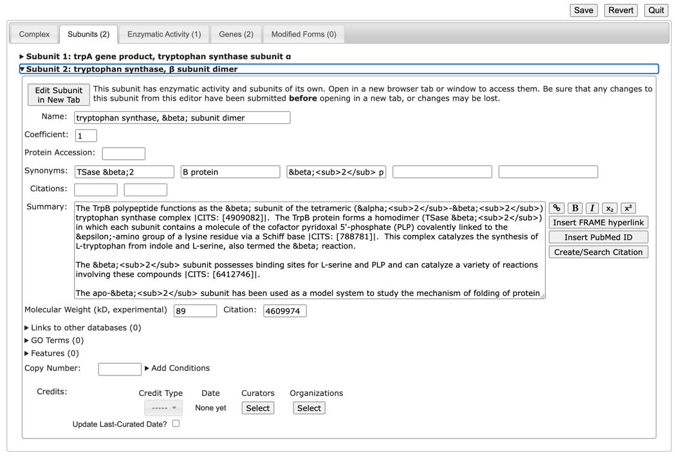
Protein Editor - subunits tab (for complexes)
Specify UniProt ID or links to other databases
Specify experimental MW and any useful info that may apply (GO terms, features, copy number)

Slide 22
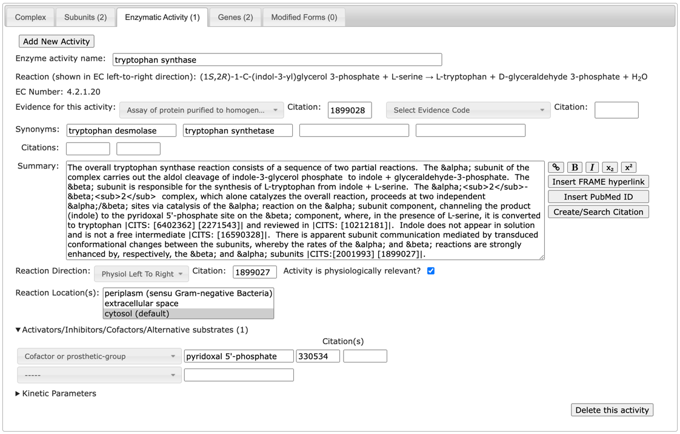
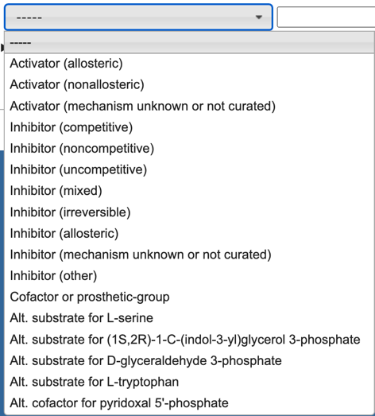
Protein Editor - enzymatic activity tab

Slide 23
How enzymatic activities are represented
Each enzymatic activity is defined by a new database object that points to an enzyme and a reaction
enzyme
enzymatic activity frame
reaction
The enzymatic activity object is a frame, like everything else in the database. It’s frame ID is in the form ENZRXN-XXX
Enzymatic activities also have a common name and potential synonyms (e.g. 2-oxoglutarate synthase)

Slide 24
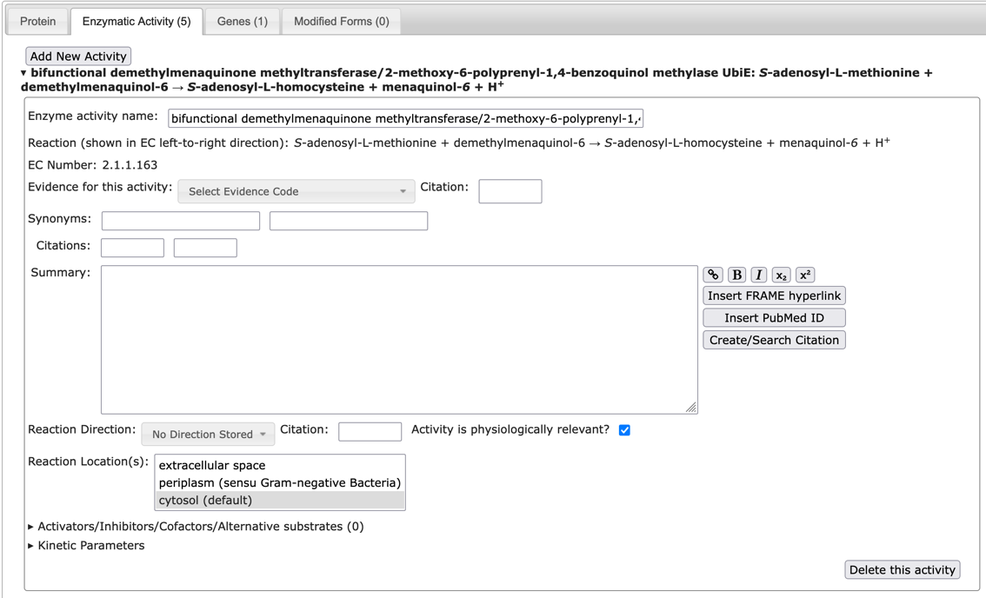
Correct assignment of reactions to enzymes
After running PathoLogic, some enzymes will be assigned to reactions incorrectly. A curator needs to remove incorrect assignments and attach correct ones.

Slide 25
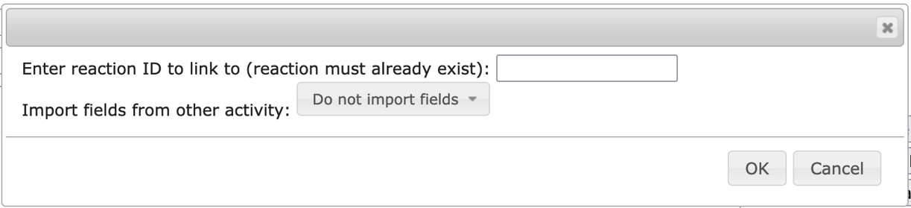
Adding an Enzymatic Activity
Add New Activity button in Enzymatic Activity tab
Find frame ID of reaction to add. Reaction must already exist either in current DB or in MetaCyc, so it if it does not, you must create it first.
If enzyme already has other activities, you have the option to copy data from existing activity.
You must supply an enzyme activity name for the new activity.

Slide 26
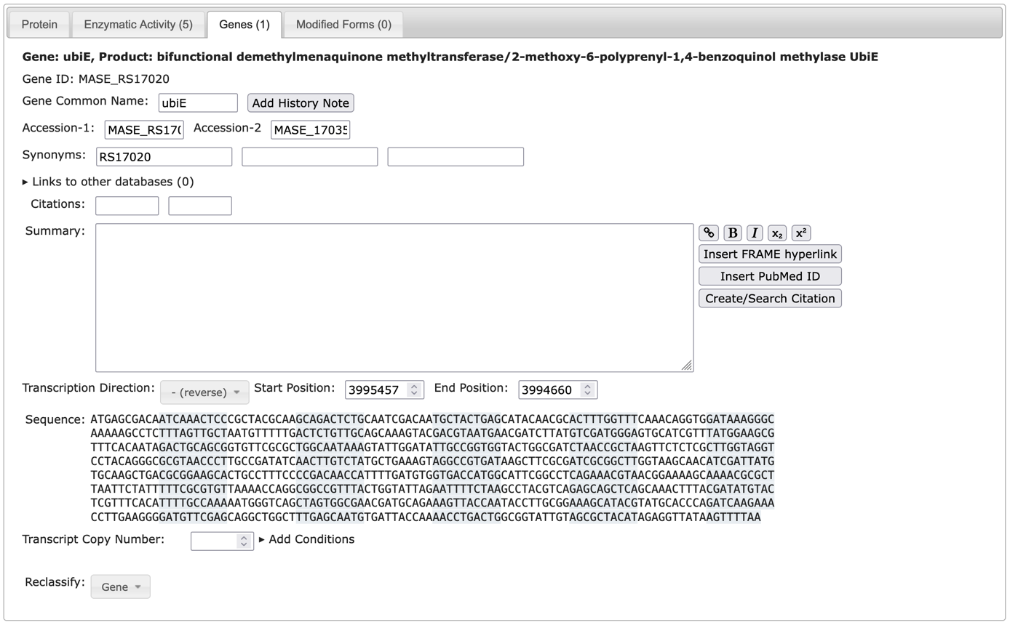
Protein Editor – genes tab

Slide 27
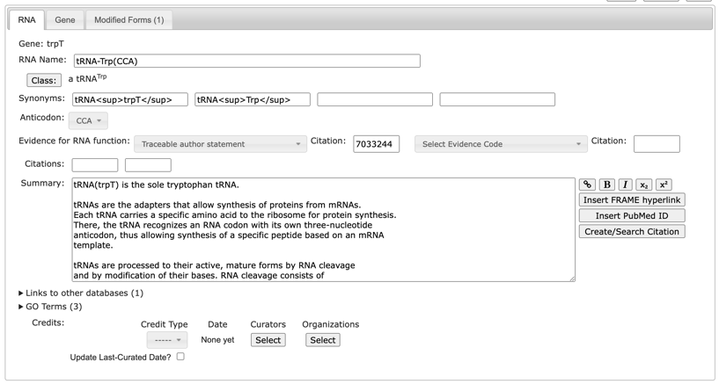
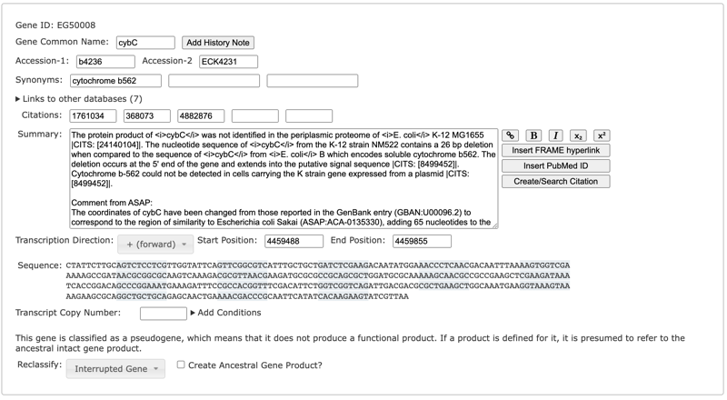
RNA Editor, Gene Editor
The RNA Editor is similar to the Protein Editor, except that the initial tab is for the RNA.
The Gene Editor is equivalent to the gene tab of the Protein or RNA Editor. It is for genes that lack products, e.g. pseudogenes.

Slide 28
Creating a New Gene
To create a new gene that has a protein or RNA product, use Edit -> Create Protein or RNA
  Create the gene and its product then use Protein or RNA Editor to edit both
To create a gene that lacks a product, i.e. a pseudogene, use Edit -> Create Pseudogene

Slide 29
Protein Complexes

Slide 30
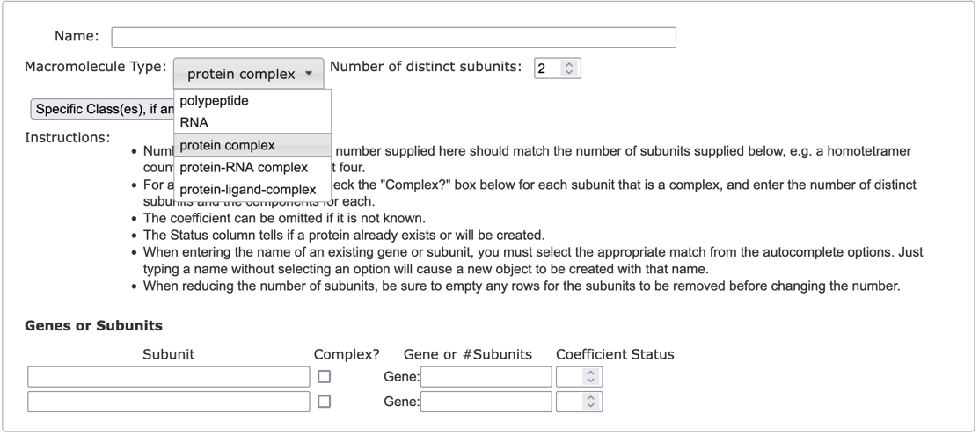
Protein Subunit Structure Editor
To edit an existing protein complex, or to convert a protein monomer to a multimer, use Protein Subunit Structure Editor command in Operations menu
To create a new heteromultimer, use Edit -> Create Protein or RNA
  Specify type (e.g. protein complex) and number of distinct subunits

Slide 31
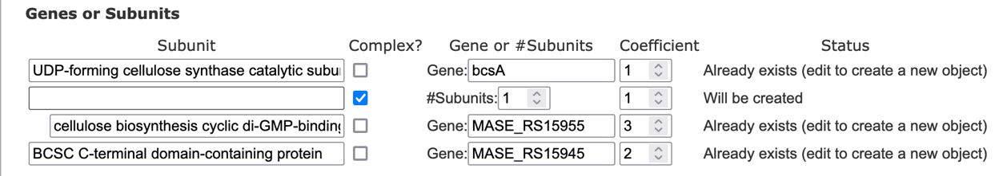
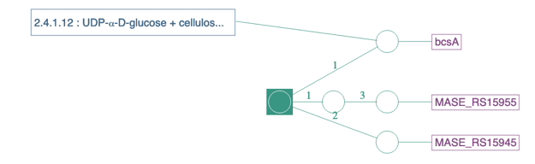
Protein Subunit Structure Editor
Enter subunit names or ids for either genes or proteins, using autocomplete
  Status column indicates whether a component already exists or needs to be created
  Software will automatically fill in missing fields (protein or gene name) for components that already exist
If a subunit is itself a subcomplex, check Complex?, and specify its number of subunits, etc.
Specify names and coefficients, as needed

Slide 32
Reactions

Slide 33
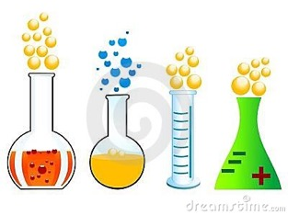
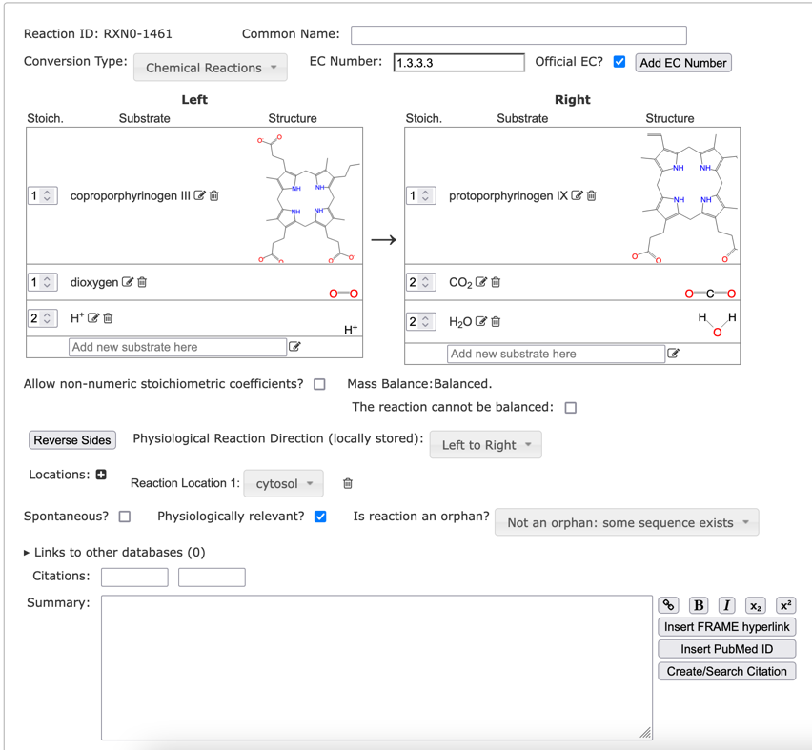
The Reaction Editor
With the Reaction Editor you can:
Enter or edit reaction substrates, stoichiometric coefficients
Specify EC numbers (official?)
Enter a common name (if no full EC number exists)
Set Conversion Type
Specify location information (transport, cellular location)
Specify reaction direction

Slide 34
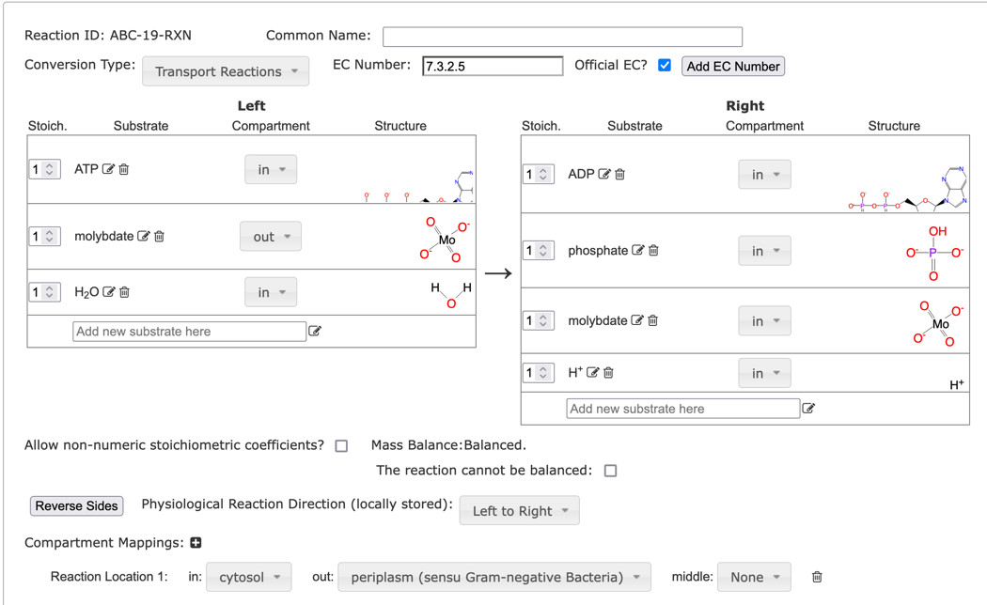
Transport Reactions
Set conversion type to Transport Reactions
Assign substrates to generic compartments in or out
Create one or more compartment mappings where in and out are mapped to specific locations, e.g. cytosol, periplasm.

Slide 35


Duplication is bad
Avoid Duplication! Reuse information whenever possible
  A PGDB should not describe the same biological or chemical entity more than once
  You should not recreate an entry already present in MetaCyc
  Some desktop-based tools help prevent the inadvertent creation of duplicate compounds and reactions, but these are not available in web editors yet
  Always check MetaCyc before creating new compound or reaction
Duplicates can be cute, but should be avoided

Slide 36
Compounds

Slide 37
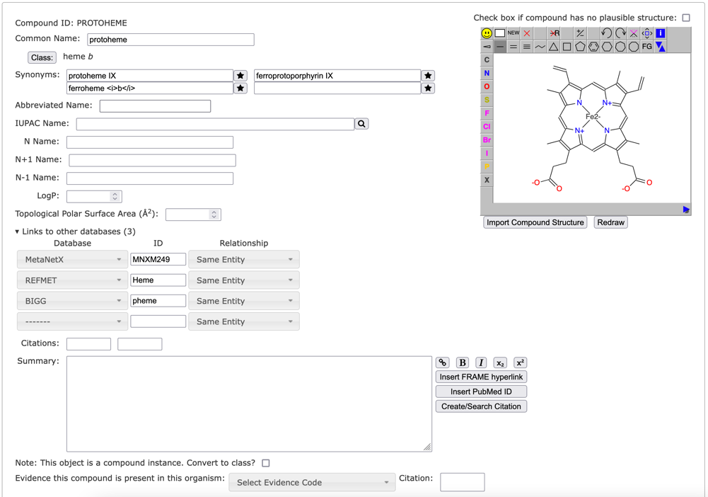
The Compound Editor
Create or edit a compound
Specify Class
Common Name
Synonyms
Links to other DBs
Edit structure using JSME
Can copy structure from another compound and edit
Can import MDL, SMILES, etc.

Slide 38
Pathways

Slide 39
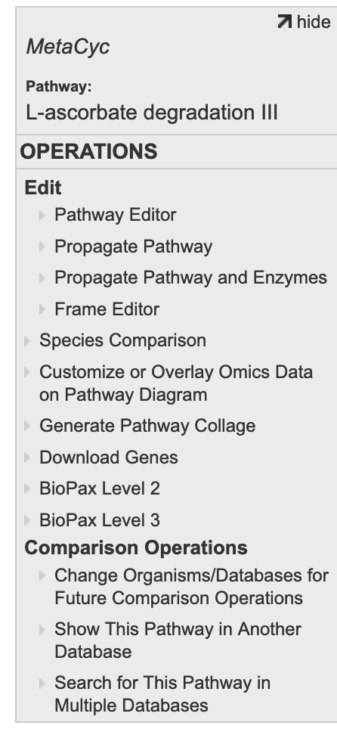
Importing Pathways from MetaCyc
Navigate to pathway in MetaCyc (or some other db)
Propagate Pathway in Operations menu
Select target organism
Do not use Propagate Pathway and Enzymes – the enzymes in MetaCyc will not match proteins in your organism
If some of the pathway reactions already exist in your db and have associated enzymes, those enzymes will automatically attach to pathway

Slide 40
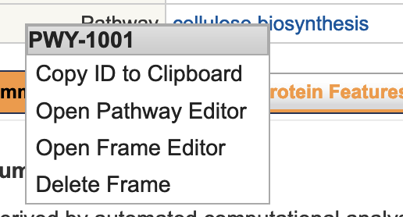
Deleting a Pathway
If a pathway was incorrectly predicted for your organism:
From some page that links to pathway (e.g. gene page, reaction page), right-click on pathway name
Select Delete Frame and confirm
If you later change your mind, you will have to manually reimport pathway from MetaCyc

Slide 41
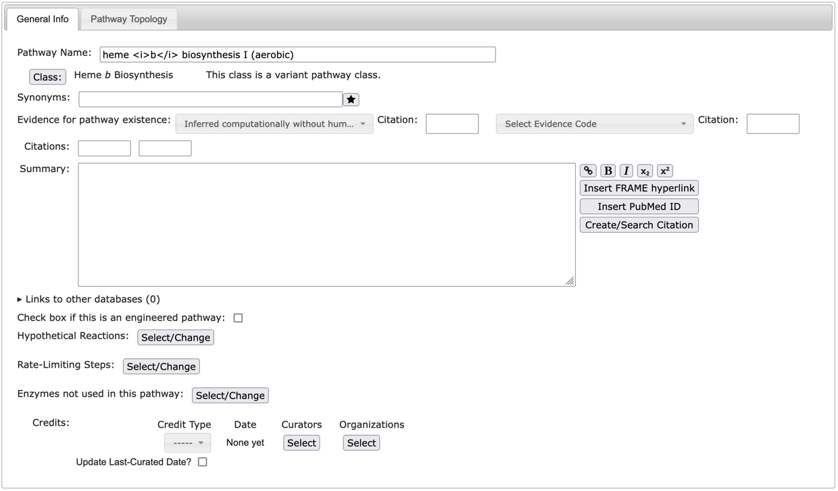
The Pathway Editor – General Info
Class (variant class)
Common Name
Synonyms
Evidence Codes
Citations
Summary
External Links
Hypothetical reactions
Key reaction
Rate-limiting steps
Enzymes not in use
Author credit

Slide 42
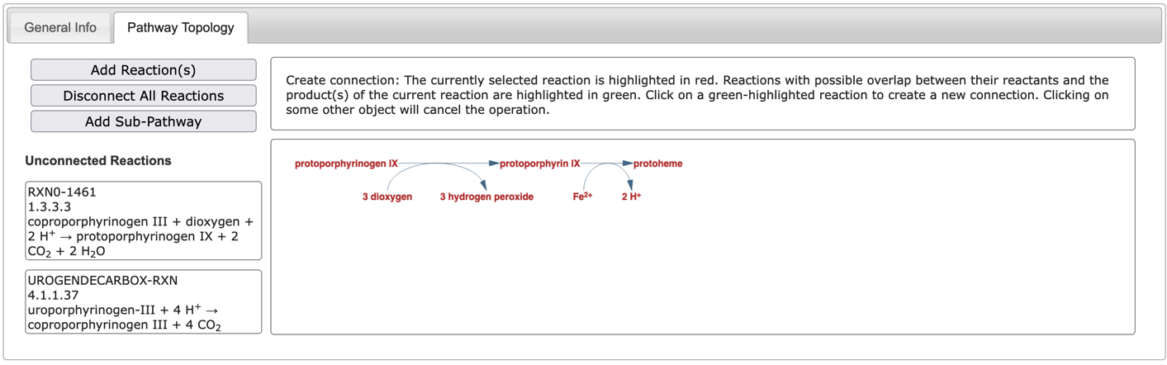
The Pathway Editor – Pathway Topology
Graphically create and modify pathways
Add reactions to pathway
Build pathway by adding connections
Display shows pathway so far

Slide 43
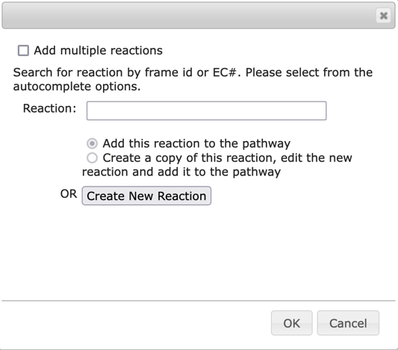
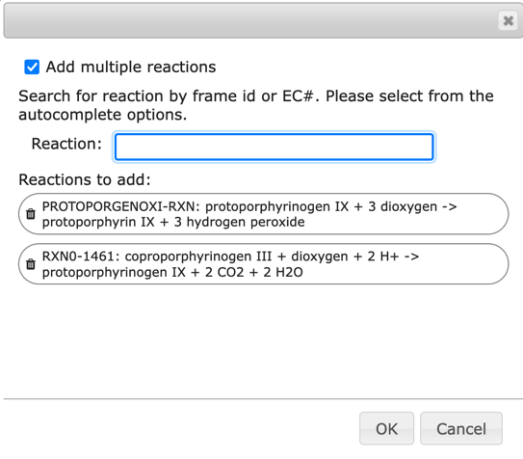
Adding reactions to a pathway
  Add Reaction(s): add one or more reactions by id or EC#
    When adding a single reaction, can create a new reaction or copy and edit an existing reaction
  Add Sub-Pathway: add sub-pathways to create a superpathway

Slide 44
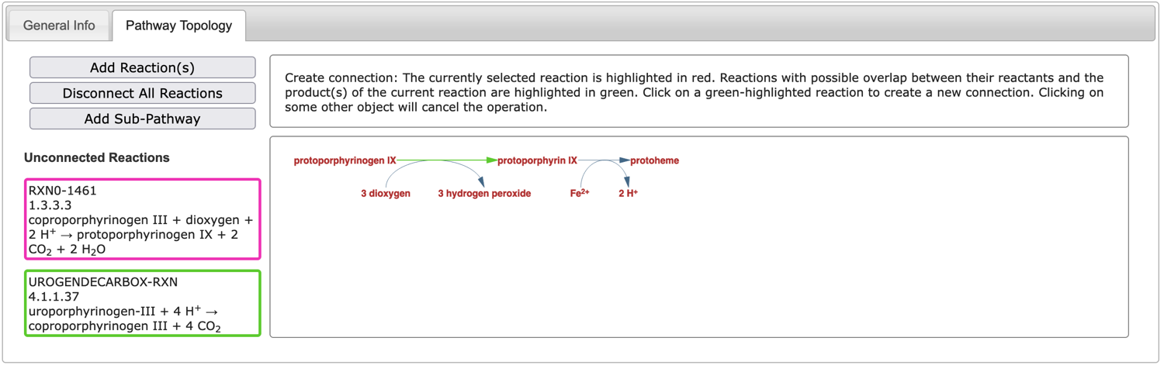
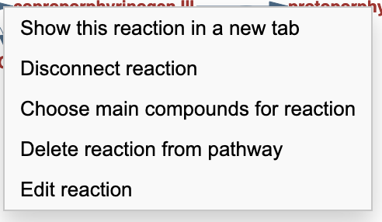
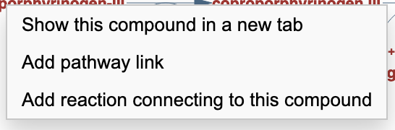
Connecting reactions
Right-click on compound or reaction for additional options

Slide 45





Pathway editor limitations
Complex situations can cause ambiguity:
  reaction directionality not specified
  reaction directionality opposite to
  direction in pathway
  dialog box for disambiguating
  pathway drawn in bizarre arrangement
Fix:
  try disconnecting reactions, specifying main compounds, and adding them in different order
Limitation: a reaction can appear only once
in a pathway.

Slide 46
Not yet covered
Transcription Unit Editor
Isoform Editor
These are low-level editors. Do not use unless instructed to do so by a BioCyc developer:
Frame Editor
Ontology Editor

