Slide 1
Orthology-Based Multi-PGDB Curation Tools
Suzanne Paley
Pathway Tools Workshop 2010

Slide 2
Motivations
Closely related organisms contain many orthologs, most likely with same functions
Leverage curation efforts across multiple PGDBs to improve quality of all
Two desired modes:
Initialize a new PGDB with information from well-curated close relative
When manual edits are made, propagate to orthologs in related organisms

Slide 3
Schema Changes
A PGDB can be designated as a master or slave PGDB
Master PGDBs point to list of slaves
Slave PGDBs point to a single master
New gene slot SYNC-W-ORTHOLOG can have the following values:
No – don’t synchronize this gene with its ortholog in any PGDB
A PGDB identifier – synchronize this gene with its ortholog in specified PGDB (same or different from master)
No value – use default heuristics to decide whether to synchronize with ortholog in master PGDB

Slide 4
What Fields can be Propagated?
Gene name
Gene synonyms
Product name
Product synonyms
Reactions catalyzed by gene product
Heteromultimeric complexes
Reactions catalyzed by complexes
GO terms with experimental evidence codes
BUT not:
Transcription units
Regulation
Coefficients on complexes
Features, post-translational modifications
GO terms with computational evidence codes

Slide 5
Propagation to New PGDB
PGDBs marked as master/slave pair
Iterate through all genes in slave PGDB to determine which should be propagated
When a gene is propagated:
All relevant data copied from master
Old values stored in history note
Computational evidence code added to GO terms, enzyme assignments
Report generated
Summarizes results
Lists genes that were not synchronized and why
Object group created of unpropagated genes

Slide 6
When should a gene be synchronized?
Slave gene does not already have non-computational evidence code
Ortholog exists in master PGDB, and has a product (i.e. not a pseudogene)
If master gene is member of a complex, orthologs exist for all other complex members
P-value < 1e-10
Length difference < 10%
Synteny: one of gene’s two nearest neighbors must be the same in both PGDBs
Slave gene not assigned to any reactions that the master gene is not assigned to

Slide 7
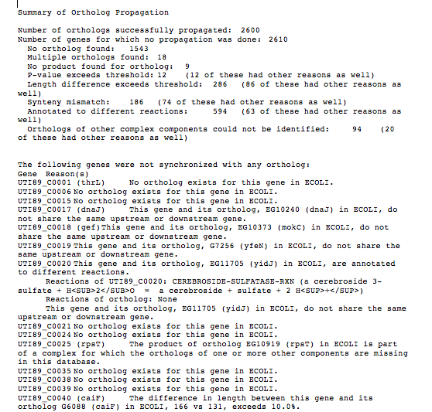
Sample Report

Slide 8
Interactive Editor
On gene page, right-click on gene name, select Edit -> Ortholog Editor

Slide 9
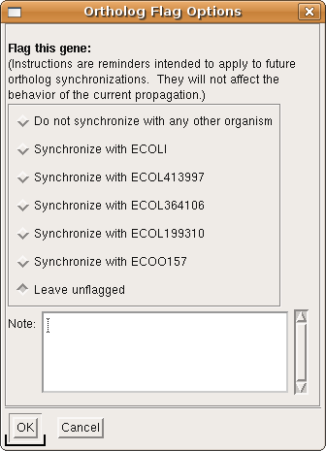

Slide 10
Limitations
Requires access to MySQL server with precomputed ortholog data
No GUI support yet for automated propagation
Synteny requirement may be overly restrictive, other parameters somewhat arbitrary

