Slide 1
Quantitative Proteomics:
Approaches and Current Capabilities
Pathway Tools Workshop
Chris Becker
Physical Sciences Division
October 27, 2010

Slide 2
There have been and can still be problems with large scale genomic and metabolomic measurements. What about proteomics?

Slide 3

What many/most scientists know about proteomics,
even if they don’t know about this publication.
Volume 359, Issue 9306, Pages 572 - 577, 16 February 2002
Use of proteomic patterns in serum to identify ovarian cancer
authors Emanuel F Petricoin … Lance A Liotta
Notes:
3

Slide 4
How do researchers differentially quantify proteins?
2-D Gels
Isotopic labeling
  iTraq (commercial reagent for tagging amine groups on lysine; read-out via MS/MS)
  SILAC (stable isotope labeling with amino acids in cell culture)
Label-free quantification

Slide 5
Label-Free Differential Profiling
Two types of label-free quantification:
  Intensity based or MS1 or MS-only
  Spectral counting (some minor variations; must re-ID each sample)
Our research group provided an early description of the approach of using signal intensities of label-free peptides and metabolites for LC-MS for quantification, including normalization.
  ASMS 2002 Meeting
  Wang et al. Analytical Chemistry 75:4818-4826 (2003)
Overcame a bias that only isotopic labeling or gel imaging could provide a quantification basis. Worry was matrix effects; the answer was to use significant chromatography times and comparing similar samples.

Slide 6
Label-Free Differential Profiling: easy to understand
What’s different between these two samples?
Sample A
Sample B

Slide 7
Label-Free Differential Profiling
Sample A
Sample B, more dilute and/or instrument losing some sensitivity over the course of a study

Slide 8
Typical spectral complexity: 1 sample in 2 minutes
Scans separated by 30 sec
Narrow 100 m/z range

Slide 9
Association of Biomolecular Resource Facilities (ABRF)
Proteomics Research Group PRG2007 Study Objectives
What methods are used in the community for assessing differences between complex mixtures?
How well established are quantitative methodologies in the community?
What is the accuracy of the quantitative data acquired in core facilities?
We wanted to build upon last years study by providing samples that were more complicated, yet more realistic.
http://www.abrf.org/prg

Slide 10

Sample Design:
Identical
Sample A
Sample B
Sample C
100 µg E. coli lysate
12 Total Protein Spikes
- 10 Non-E. coli proteins
- 2 E. coli proteins
100 µg E. coli lysate
12 Total Protein Spikes
- 10 Non-E. coli proteins
- 2 E. coli proteins
100 µg E. coli lysate
12 Total Protein Spikes
- 10 Non-E. coli proteins
- 2 E. coli proteins
Spikes at Different Levels and Ratios

Slide 11
Techniques Applied

Slide 12
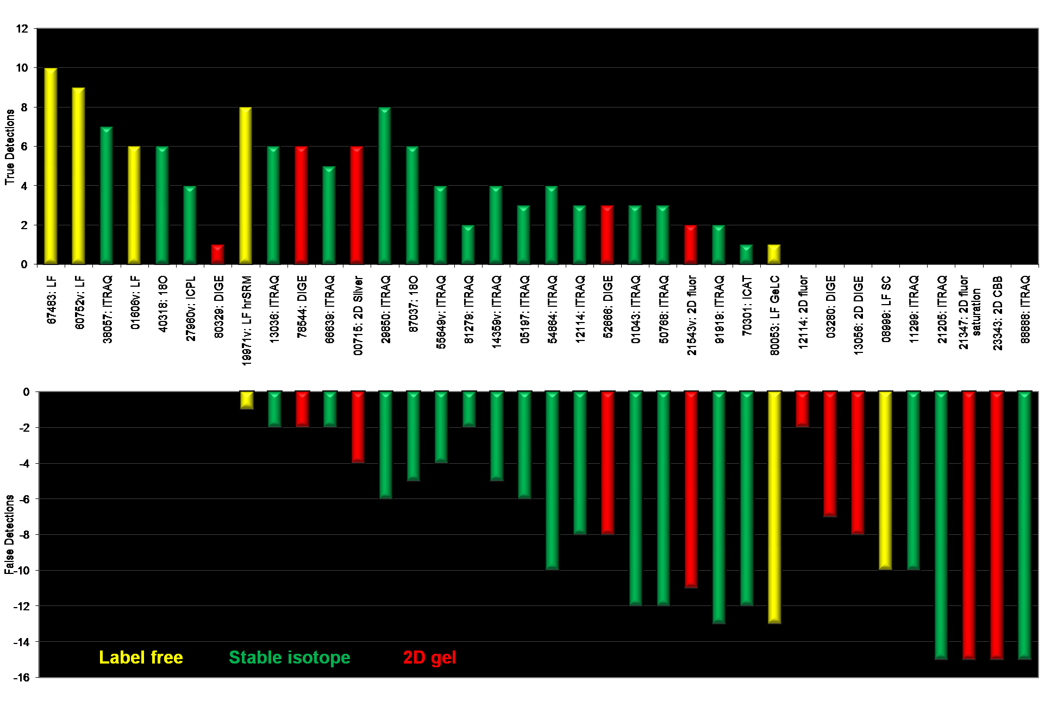
Performance of Various Proteomics Approaches
Results from 36 Laboratories: True Positives vs False Positives
Becker
lab
Note performance overall of label-free (yellow) results

Slide 13
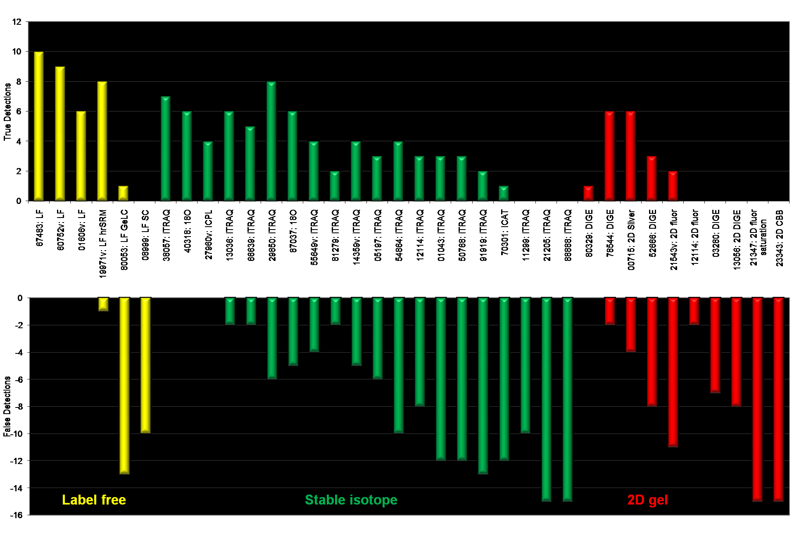
Performance of Various Proteomics Approaches
Results from 36 Laboratories: True Positives vs False Positives
Note performance overall of label-free (yellow) results

Slide 14
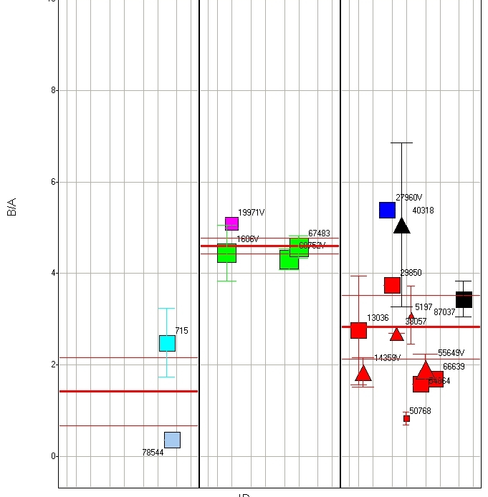
Quantitative Accuracy: Ubiquitin
2D Gels
Label-Free
Stable Isotope Labeling
A = 5 pmol
B = 23 pmol
8
6
B/A Ratio
Anticipated Mole Ratio 4.6
4
Color Indicates Method Used
iTRAQ
ICPL
ICAT
¹⁸O Labeling
Label Free
Label Free + targeted SRM
2D-Gels (nonDIGE)
2D-DIGE
2
0

Slide 15
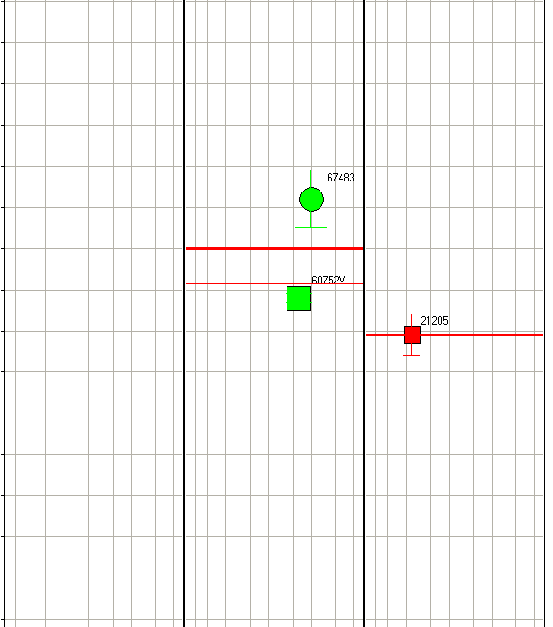
Quantitative Accuracy: Glucose Oxidase
2D Gels
Label Free
Stable Isotope Labeling
A = 0.5 pmol
B = 0.33 pmol
1
0.8
Anticipated Mole Ratio 0.67
0.6
B/A Ratio
Color Indicates Method Used
iTRAQ
ICPL
ICAT
¹⁸O Labeling
Label Free
Label Free + targeted SRM
2D-Gels (nonDIGE)
2D-DIGE
0.4
0.2
0

Slide 16
Reproducibility Testing:
Process and Instrument Variation Workflow
Sample Processing
LC-MS
Processed samples
are pooled before
analysis and
replicates are run
1
IQC –Instrument QC
Variation due to the
LC and Mass Spec
2
3
Pooled
human serum
4
PQC –Process QC
Variation due to sample
processing in addition to
the LC and Mass Spec
Processed samples
are run individually
5
n
Sample aliquots
are processed

Slide 17
Proteome QC Report extracted from a 4-batch human plasma study
(~8000 components)
IQC samples
Instrument
Variation
6% median CV
8% mean CV
PQC samples
Processing
plus
Instrument
Variation
14% median CV
17% mean CV

Slide 18
Example of quantification and the effect of a PTM, oxidation. In CSF.

Slide 19
Typical Metrics for Proteomics
Coefficients of variations ~ 20%
Accuracy ~ 20%
One-dimensional (1D) analysis
  Track, identify and quantify approximately 1,000 proteins.
Two-dimensional (2D) analysis
  Track, identify and quantify approximately 2,000 proteins.
False discovery rate < 1% for identification (decoy database)
False discovery rate p-value < 0.01 for differential expression (Benjamini Hochberg, Storey)

