Slide 1
Tutorial: Pathway Tools Software
Peter D. Karp ecocyc.org
SRI International biocyc.org
metacyc.org

Slide 2
[This presentation takes about 20 minutes]

Slide 3
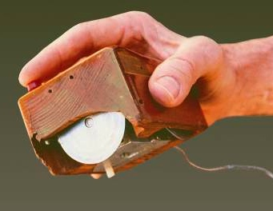
SRI International
An independent, nonprofit corporation
Founded by Stanford University in 1946
Independent in 1970; changed name from Stanford Research Institute to SRI International in 1977
More than 20 locations worldwide
SRI spin-off Siri, acquired by Apple in 2010 and offered on the iPhone 4S, offers a virtual personal assistant—a new way to interact with the Internet on your mobile phone. Siri was born from the CALO project, an ambitious artificial intelligence program SRI led for DARPA.
1964–1968: SRI’s Doug Engelbart and team invented the computer mouse and demonstrated the foundations of personal computing.

Slide 4
Technology Spin-off Ventures Growth opportunities that bring SRI innovations to market
Publicly Traded
Robotics
DNA testing services*
Speech recognition for customer service
Electroadhesion for materials handling
Innovative robots for manufacturing/service
Surgical robotics
Information Technology
Smart calendar for iPhone
Video enhancement systems
Customer
service tools*
Educational gaming platform
Travel search and planning
Next-generation personalized web search tool
Virtual personal assistant for the iPhone*
Video-on-demand services**
Wireless mesh networks*
LCD technology*
Real-time web video streaming and sharing
Iris biometric identification*
Technology for K-12 and higher education
Digital imaging system
Stray voltage detection services
Enterprise social
media technology
Panoramic image editing software*
Electronic signature solutions
Materials
Biomedical
Electroactive polymers*
Metal “print and plate”
manufacturing process
Digital color printing applications*
Super-bright LED light engines*
Drug dispensing system*
Drug discovery
Environmentally friendly light products*
(formerly Rosedale Medical) Glucose monitoring system
Disposable hearing aid*
Portable power systems**
Optical network components
Anti-counterfeiting systems
*Acquired or merged
** Dissolved
OPPORTUNITIES
PROFILE
INNOVATIONS
CAPABILITIES
PROGRAMS

Slide 5
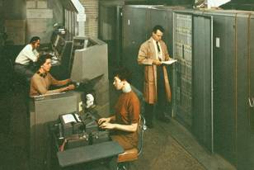
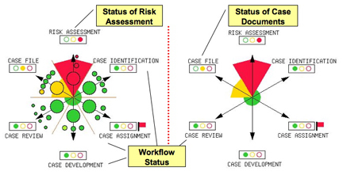
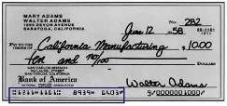
Banking SRI revolutionized how money is moved and used
1950–1955: SRI revolutionized banking with automatic check processing and magnetic ink character recognition (MICR) for Bank of America.
1958: SRI’s innovations encouraged BofA to start the first national credit card system (more than one billion VISA cards issued to date).
Today: For the Internal Revenue Service (IRS), SRI’s Structured Evidential Argumentation System (SEAS) protects against abusive accounting practices.
“The world’s first successful use of computers in business operations was created by SRI for the world’s largest bank...it saved the banking industry.”
Bank of America
OPPORTUNITIES
PROFILE
INNOVATIONS
CAPABILITIES
PROGRAMS

Slide 6
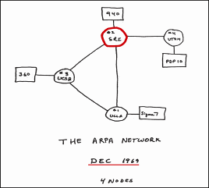
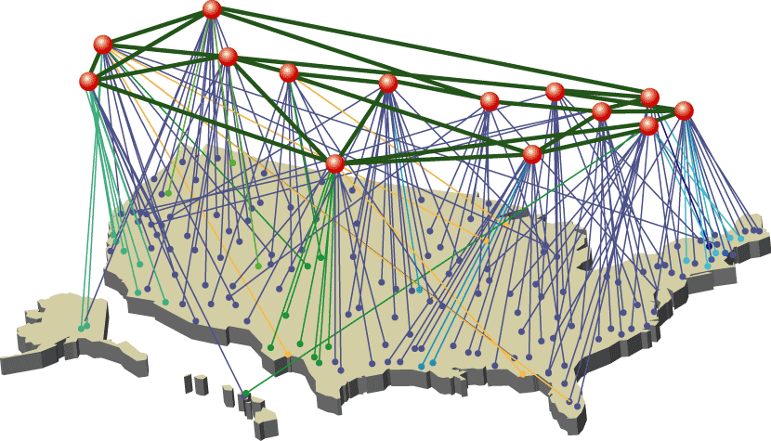
Internet and Networks SRI was there “before the beginning”
.com
.gov
.org
1969: SRI received the first logon to the ARPANET, predecessor of the Internet.
1970–1992: SRI ran the Network Information Center (NIC), the domain name registration clearinghouse for all computer hosts connecting to the ARPANET and Internet. SRI assigned all .com, .org, and .gov domain names.
1987: SRI’s pioneering network intrusion detection technology protects against malicious attacks.
Today: For the Department of Homeland Security, SRI administers the Cyber Security R&D Center, which develops technology for protection of the U.S. cyber infrastructure through partnerships with industry, the venture community, and the research community.
Today: SRI’s online Malware Threat Center helps network administrators understand current and emerging computer security threats and provides key network defense information.
OPPORTUNITIES
PROFILE
INNOVATIONS
CAPABILITIES
PROGRAMS

Slide 7
Tutorial Overview
Mix of lectures and lab sessions
Questions encouraged at any time
Let us know if terminology is unclear

Slide 8
Tutorial Overview
Mix of lectures and lab sessions
Lab sessions will be held in breakout rooms
Work on assigned problem sets
Questions encouraged at any time – submit via Chat

Slide 9
Introductions
BRG Staff
Attendees
Where are you from?
What genome?
Have you used Pathway Tools before?
How do you hope to use Pathway Tools?
What do you hope to get out of the tutorial?

Slide 10
Introductory Tutorial Goals
General familiarity with Pathway Tools goals and functionality
Ability to create, edit, and navigate a new PGDB
Create new PGDB for genome(s) you brought with you
Familiarity with information resources available about Pathway Tools to continue your work

Slide 11
Introductory Tutorial Goals
General familiarity with Pathway Tools goals and functionality
Basic Navigator functionality: search, omics analysis, SmartTables
Familiarity with information resources available about Pathway Tools to continue your work

Slide 12
Metabolic Modeling Tutorial Goals
Learn basic principles of FBA
Learn to run existing FBA models in Pathway Tools
Learn to develop new FBA models in Pathway Tools
Familiarity with information resources available about Pathway Tools to continue your work

Slide 13
Administrative Details
Please wear badges at all times
Escort required outside this room/hallway
Let us know when you are leaving
Use E-Bldg Entrance
Phone numbers to call from entrance
x1980
Meals
Restrooms

Slide 14
Terminology
“Database” = “DB” = “Knowledge Base” = “KB” = “Pathway/Genome Database” = “PGDB”

Slide 15
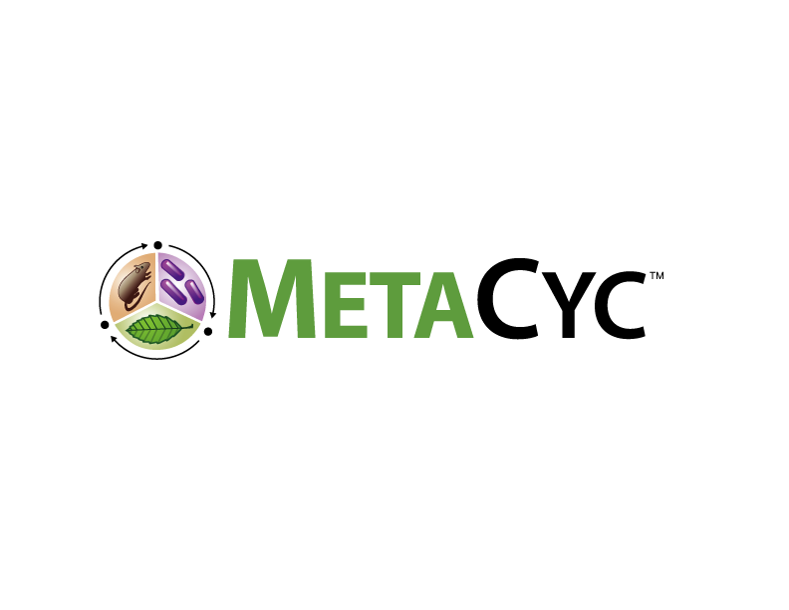
MetaCyc Family of Pathway/Genome Databases
30,000+ databases from many institutions
All domains of life with microbial emphasis
Genomes plus predicted metabolic pathways
DBs derived from MetaCyc via computational pathway prediction
Common schema
Common controlled vocabularies
Managed using Pathway Tools software
MetaCyc Family
30,000+
BioCyc.org
19,000
Archives of Toxicology 85:1015 2011

Slide 16
BioCyc Web Portal and Database Collection
BioCyc Database Collection
Encyclopedic reference on genomes, pathways, and regulation
18,000 total databases
60 curated databases, contents derived from 130,000 publications
BioCyc.org Website
Information seeking
Transcriptomics data analysis
Metabolomics data analysis
Comparative analysis
Metabolic engineering
Pathway Tools Software
Install a private set of BioCyc databases
Create PGDBs from your own genome data
Enterprise pathway/genome data management
Edit PGDBs interactively to add new gene functions and pathways
Build quantitative metabolic flux models using Flux-Balance Analysis with MetaFlux
Same use cases as BioCyc
Runs as desktop application or web server

Slide 17
Highly Curated Pathway/Genome Databases
Database | Organism | Organization | Publications Curated From
MetaCyc | Multiorganism | SRI | 68,000
EcoCyc | E. coli | SRI | 39,000
BsubCyc | B. subtilis | SRI | 4,000
HumanCyc | H. sapiens | SRI
AraCyc | A. thaliana | TAIR/Carnegie Institution | 4,100
YeastCyc | S. cerevisiae | SGD/SRI | 980
MouseCyc | M. musculus | MGD/Jackson Laboratory
http://biocyc.org/otherpgdbs.shtml

Slide 18
Creation of BioCyc Databases (PGDBs)
Computational Inferences
Predict metabolic reactions
Predict operons
NIH RefSeq
Predict transport reactions
Compute orthologs
Predict metabolic pathways
Compute Pfam domains
Predict pathway hole fillers
Curation: Tiers 1-2
PGDB
Metabolic Model
Regulatory data [regtransbase]
Database links
Organism phenotype data
Subcellular locations [psortdb]
Gene essentiality data
GO terms [uniprot]
Protein features [uniprot]
Data Import

Slide 19
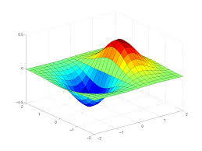
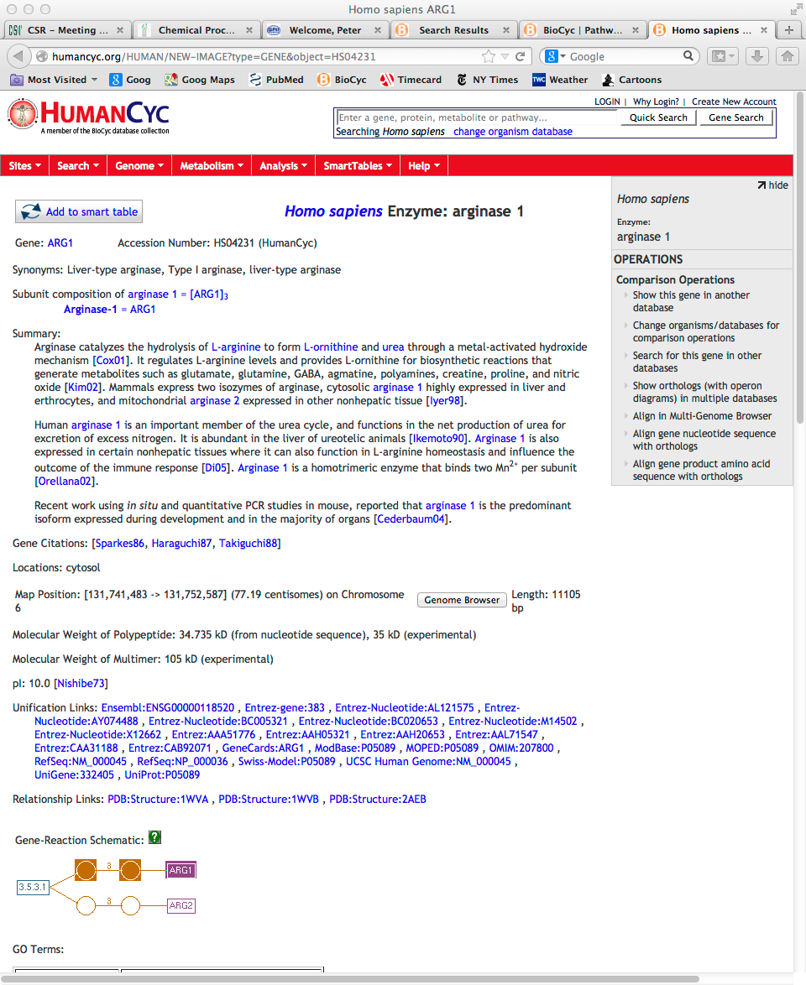
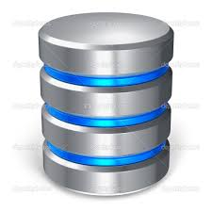
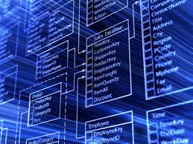
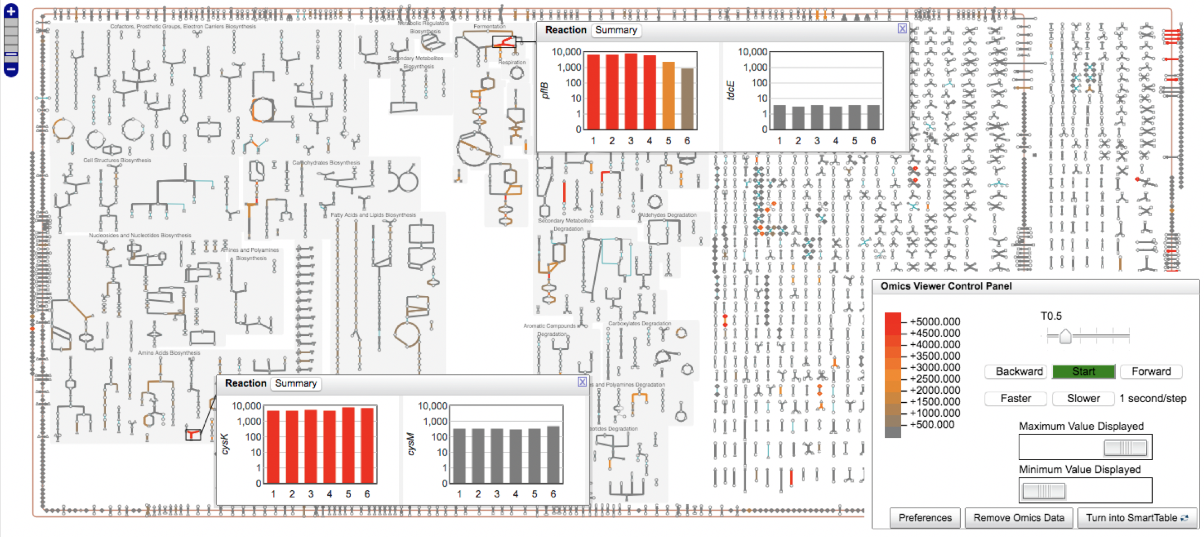
Pathway Tools Enables Multi-Use Metabolic Databases
Encyclopedia
Metabolic Model
Queryable Database
Zoomable Metabolic Map / Omics Data Analysis
Notes:
Mention that all of these five usage facets are validated.

Slide 20
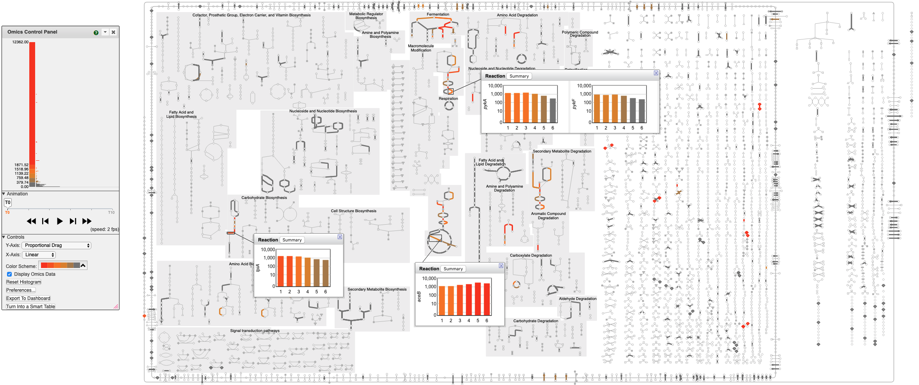
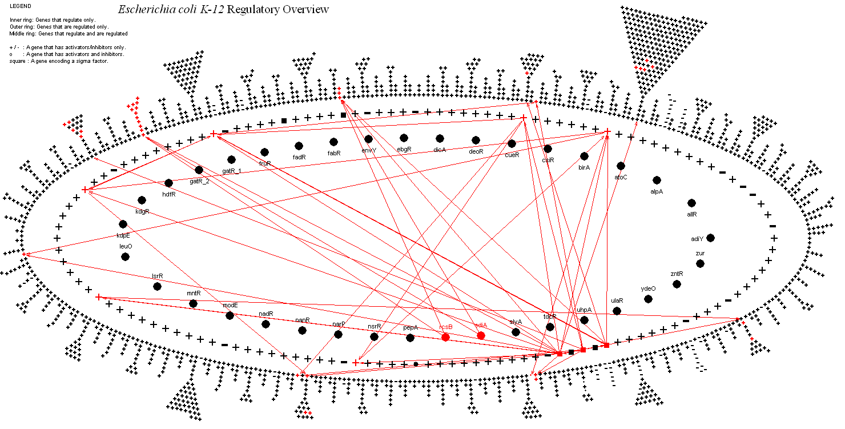
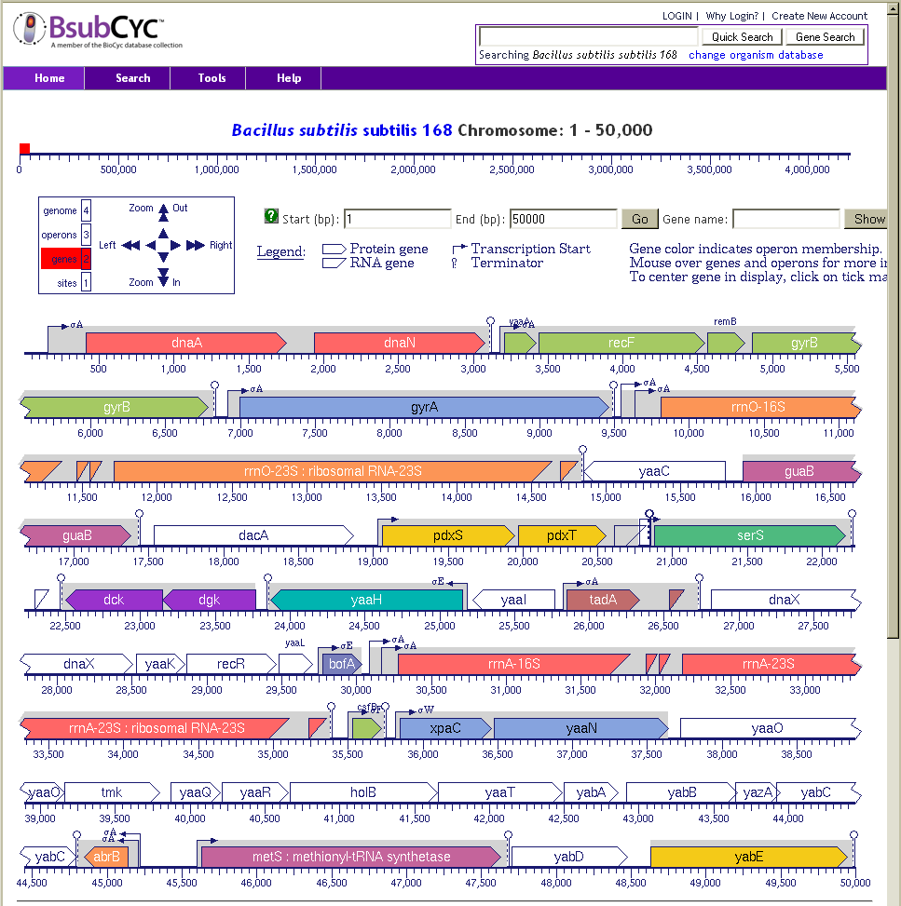
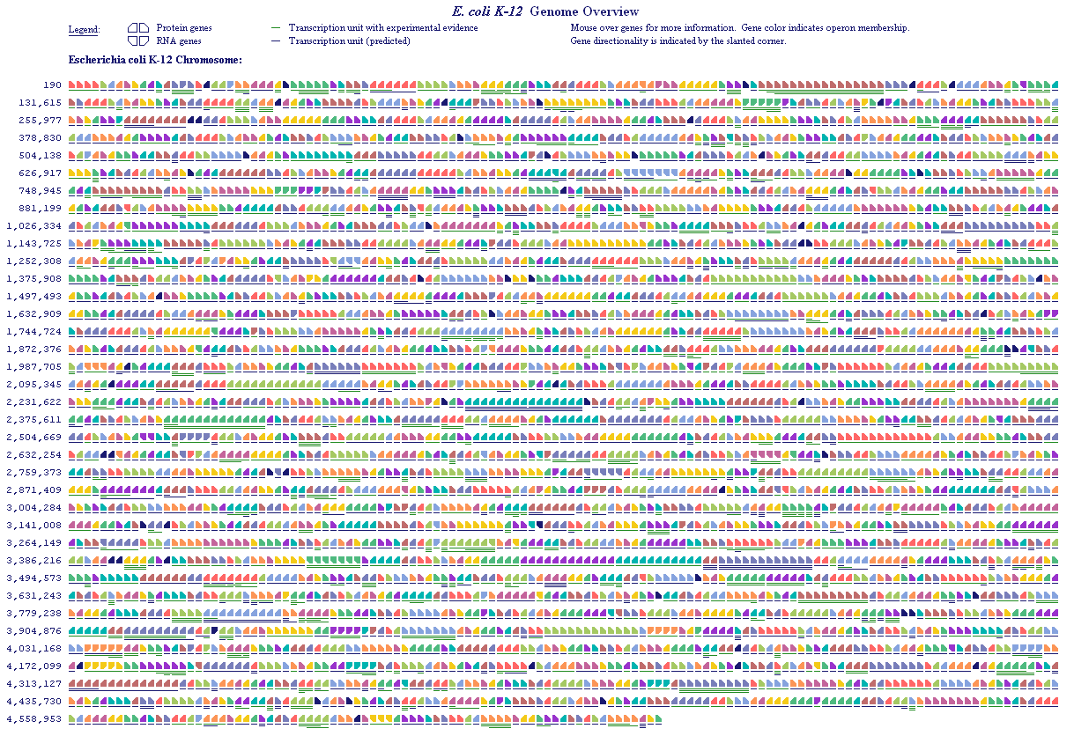
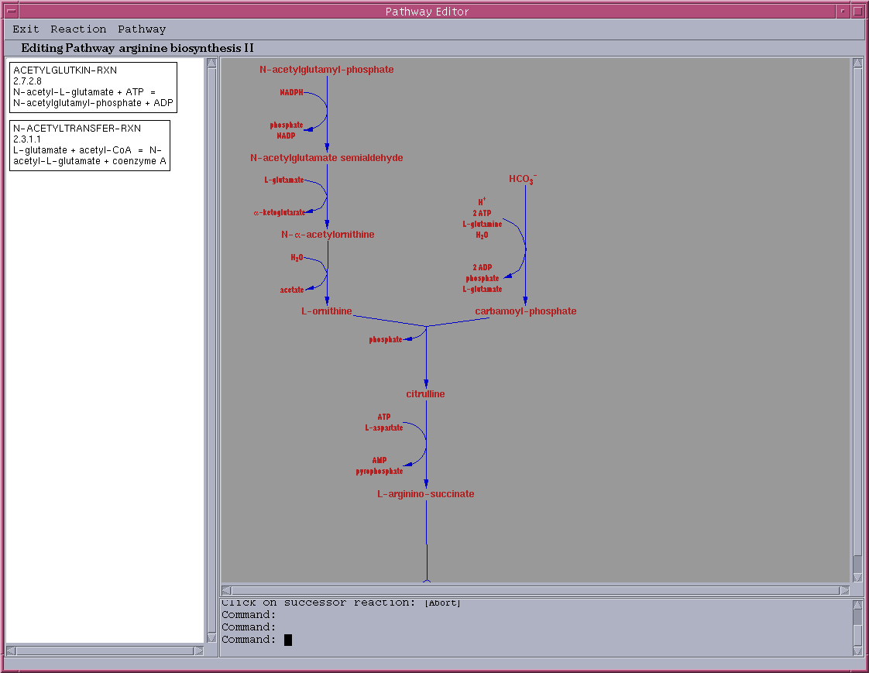
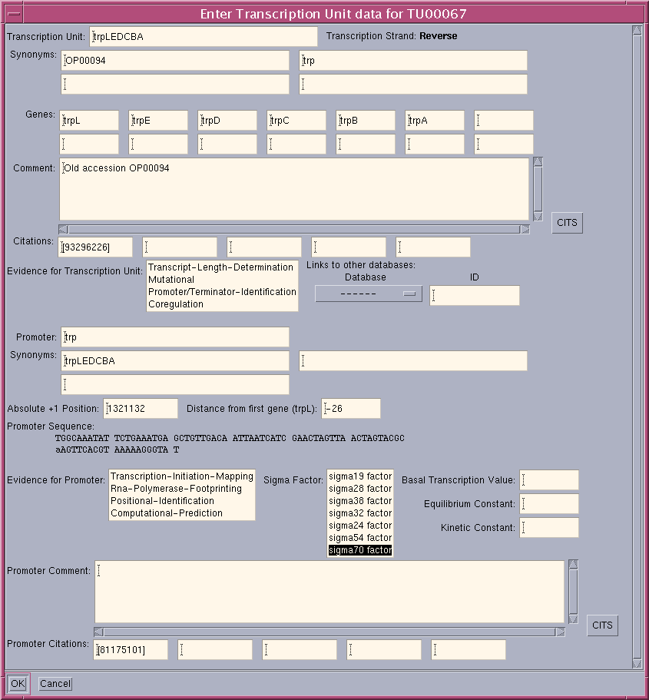
+
Annotated
Genome
PathoLogic
MetaCyc
Pathway/Genome
Database
Pathway/Genome
Navigator
MetaFlux
Pathway/Genome
Editors
Briefings in Bioinformatics 11:40-79 2010
Web+Desktop Mode/BioCyc Subscription
Desktop Mode Only
Licensed by 12,000+ Groups

Slide 21
Pathway Tools Capabilities
Microbiome Informatics
Calculate pathway abundances across metagenome samples
Create PGDBs for an organism community
Analysis of meta-omics data
Comparative Analysis
Search across PGDBs for genes, proteins, pathways, metabolites
Comparative genome browser
Compare pathway, reaction, and metabolite complements
Transcriptomics and Metabolomics Data Analysis
Enrichment analysis
Paint transcriptomics data onto pathways, zoomable metabolic network
Omics Dashboard
Sort pathways by pathway activation score
Pathway covering analysis
Advanced Data Manipulation
SmartTables
Advanced Query Interface
Interactive editing tools
APIs: Python, Perl, Java, Lisp, R, web services
Import/Export: SBML, GenBank, GFF3, BioPAX, tab-delimited files
Genome Informatics
Gene/protein/RNA searches, gene information page
Genome browser
BLAST search
Sequence pattern search
Multiple sequence alignment
Sequence retrieval
Pathway Informatics
Reaction/metabolite/pathway searches and info pages
Infer metabolic network from genome
Zoomable metabolic network diagrams
Metabolic network explorer
Metabolic route search for single organisms and communities
Pathway-based inference of nutrient requirements
Metabolic modeling using flux-balance analysis
FBA, dFBA, FVA, gap filling, blocked metabolites
Regulatory Informatics
Capture/visualize promoters, transcription factor binding sites
Visualize regulon of transcription factor
Regulatory network viewer
Operon inference

Slide 22
MetaCyc: Metabolic Encyclopedia
Experimentally determined metabolic pathways, reactions, enzymes, and compounds
Literature-based DB with extensive references and commentary
Derived from 68,000 publications
MetaCyc pathways from all domains of life, experimentally elucidated
Jointly developed by
R. Caspi, P. Karp, SRI International
Nucleic Acids Research 2020 Database Issue

Slide 23
MetaCyc: Curated Metabolic Database
 | MetaCyc v25.1 August 2021 | KEGG v99.0+ August 2021
Genomes | 19,500 | 7,735
Citations | 69,000
Pathways | 2,969 | 400 modules
Reactions | 17,412 | 11,603
Metabolites | 17,572 | 18,842
Mini-reviews (textbook pages) | 9,739
MetaCyc is free and open, contains computed atom mappings
“A Systematic Comparison of the MetaCyc and KEGG Pathway Databases”
BMC Bioinformatics 2013 14(1):112

Slide 24
Information Sources
Pathway Tools User’s Guide
/root/aic-export/pathway-tools/ptools/25.0/doc/manuals/userguide.pdf
NOTE: Location of the aic-export directory can vary across different computers
Pathway Tools Web Site
http://pathwaytools.com/
Publications, FAQ, programming examples, etc.
Slides from this tutorial
http://www.pathwaytools.org/tutorial/sessions/
BioCyc Webinars
http://biocyc.org/webinar.shtml
BioCyc Help Menu
Basic Help
Search Help
BioCyc Glossary
Publications
Website User Guide
PGDB Concepts
Guide to EcoCyc
Guide to MetaCyc

Slide 25
Information Sources -- Publications
Primary Pathway Tools citation:
"Pathway Tools version 23.0 update: Integrated Software for Pathway/Genome Informatics and Systems Biology," Briefings in Bioinformatics 2019.
Pathway Tools overview publication:
"Pathway Tools version 24.0: Integrated Software for Pathway/Genome Informatics and Systems Biology", 2020, http://arxiv.org/abs/1510.03964
Primary BioCyc citation:
" The BioCyc collection of microbial genomes and metabolic pathways", Briefings in Bioinformatics, 2019.

Slide 26
Reporting Pathway Tools Problems
ptools-support@ai.sri.com
Comprehensive bug reports are required for us to fix the problem you reported
What platform you are running on
What version of Pathway Tools you are running
The error message
Result of [1] EC(2) :zoom :count :all
What operation were you performing when the error occurred?
New patches automatically downloaded and loaded with PTools starts up
Pathway Tools User Forum / FAQ site: http://ask.pathwaytools.com

Slide 27
Surveys / Feedback
Please complete survey at end of each day
Your feedback and suggestions on the software are important to us!

Slide 28
PGDB(s) That You Build
Before you leave
Tar up your PGDB directory and FTP it home, email it home, or copy it to flash disk
We will create a backup copy of your PGDB directory if the directory is still there at the end of the tutorial
Delete the PGDB directory if you don’t want us to back it up
We will not give the backed up data to anyone else

Slide 29
Summary
Pathway Tools and Pathway/Genome Databases
Not just for pathways!
Computational inferences
Operons, metabolic pathways, pathway hole fillers
Editing tools
Analysis tools: Omics data on pathways
Web publishing of PGDBs
Main classes of users:
Develop PGDB to extract more information from genome for genome paper
Develop a model-organism DB for the organism that is updated regularly and published on the web
Develop a metabolic flux model

