Slide 1
A Community Effort to Model the Human Microbiome
Peter D. Karp
SRI International biocyc.org

Slide 2
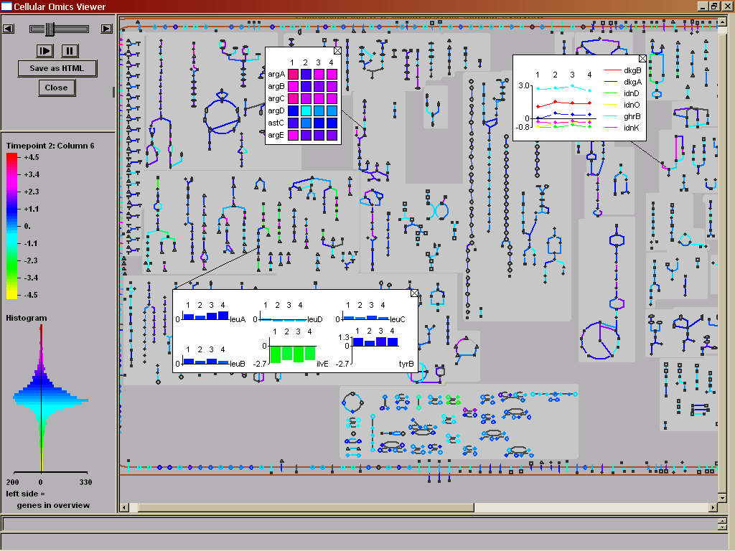
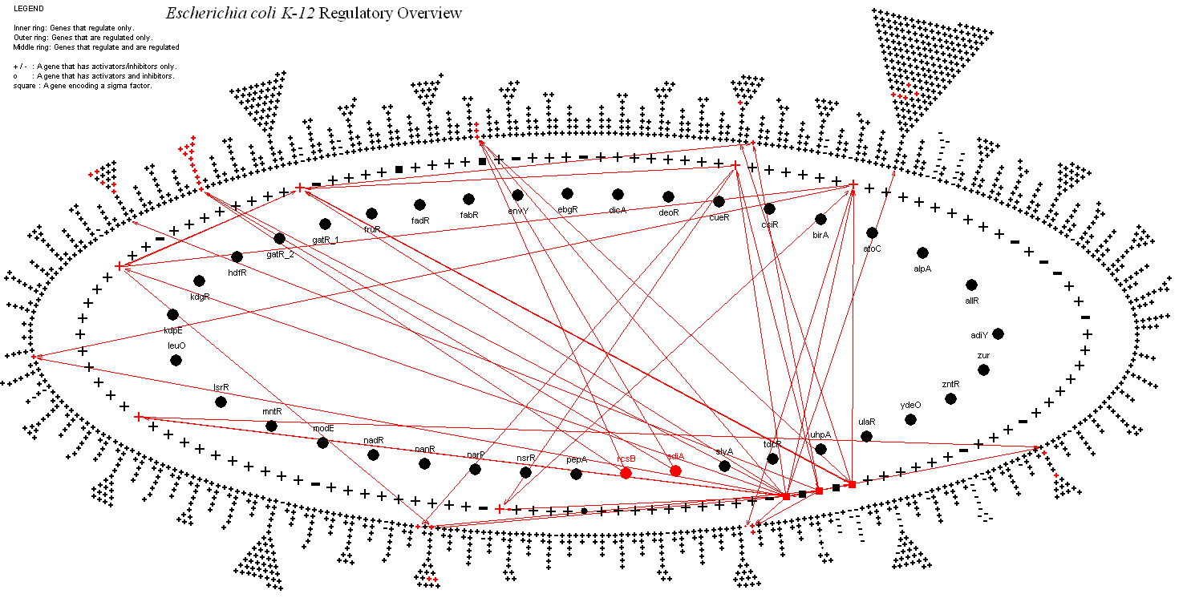
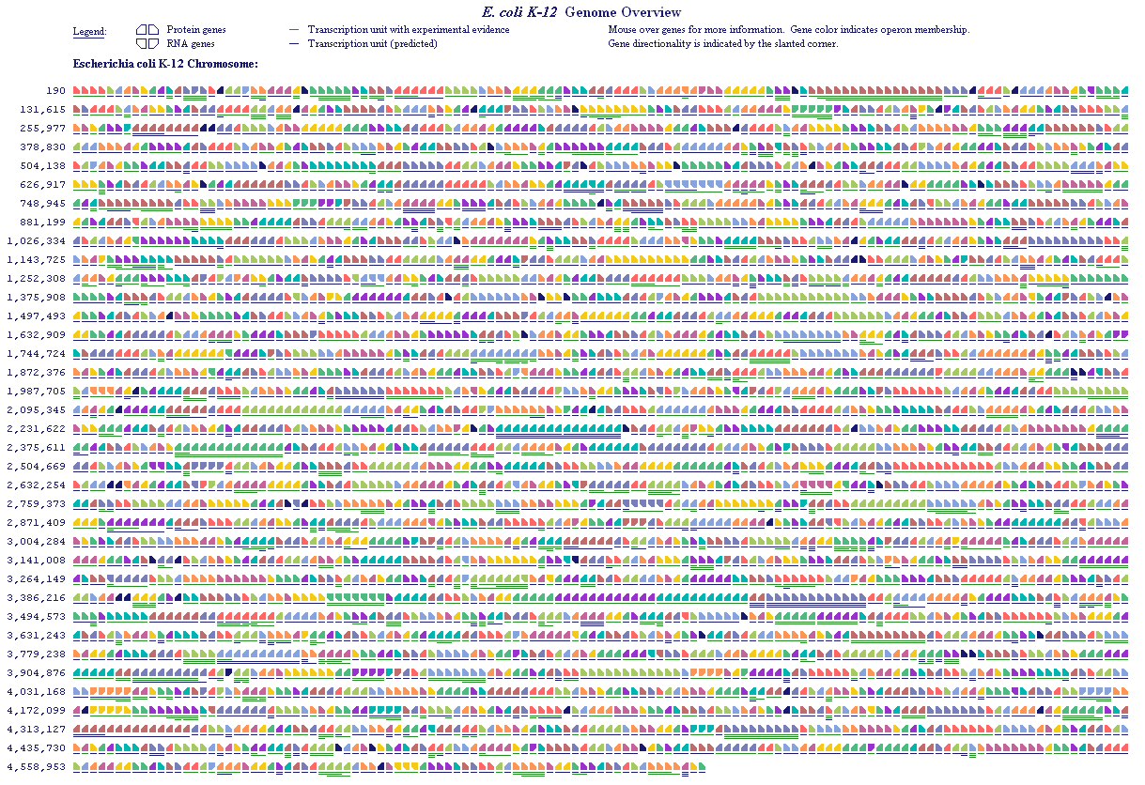
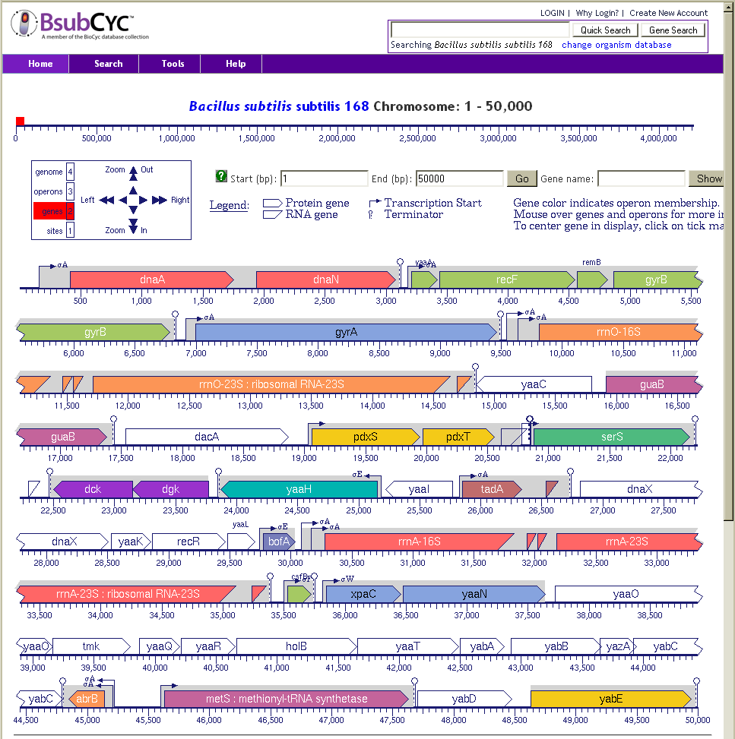
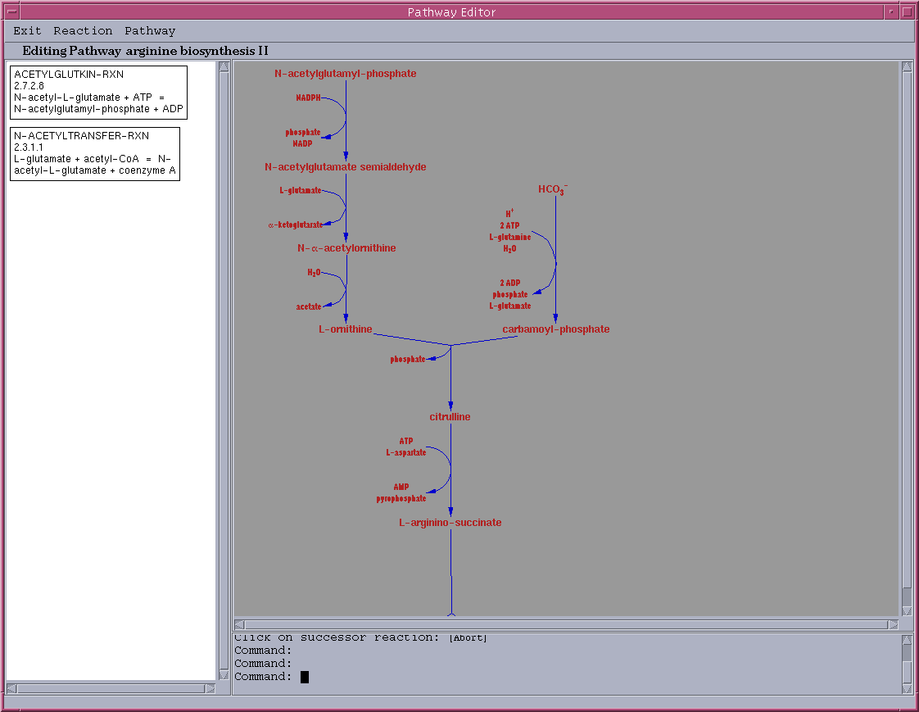
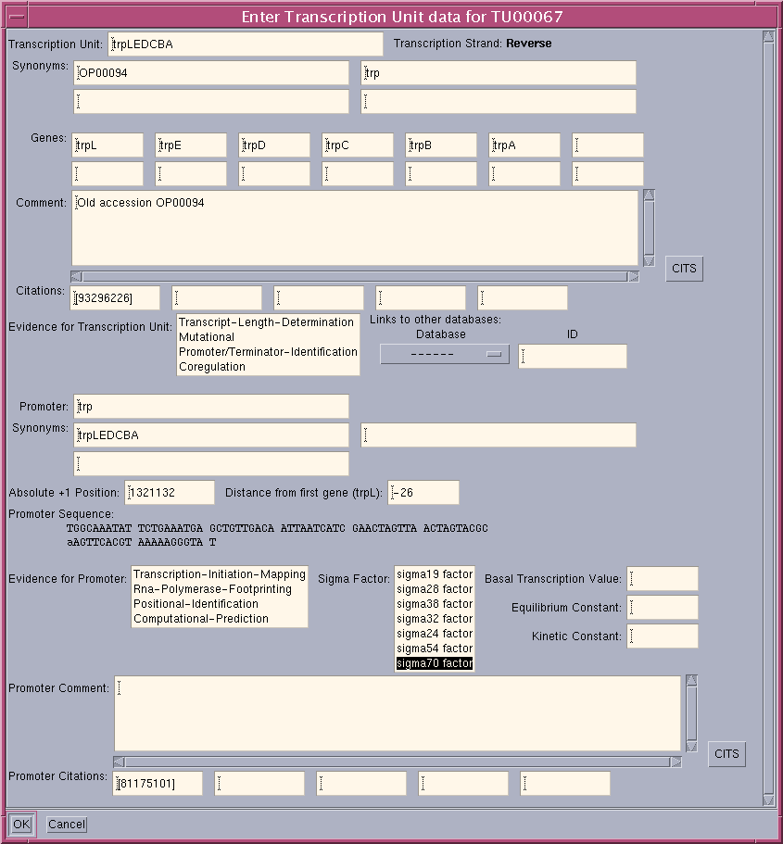
+
Annotated
Genome
PathoLogic
MetaCyc
Pathway/Genome
Database
Pathway/Genome
Navigator
MetaFlux
Pathway/Genome
Editors
Briefings in Bioinformatics 11:40-79 2010
Licensed by 8,000+ Groups

Slide 3
Creation of BioCyc Databases
Computational Inferences
NIH RefSeq
Predict metabolic reactions
Predict operons
Predict transport reactions
Compute orthologs
Predict metabolic pathways
Compute Pfam domains
Predict pathway hole fillers
Curation
PGDB
Metabolic Model
Regulatory data [regtransbase]
Database links
Organism phenotype data
Subcellular locations [psortdb]
Gene essentiality data
Phenotype microarray data
GO terms [uniprot]
Protein features [uniprot]
Data Import

Slide 4
Big Picture
Transition microbiome studies toward a mechanistic, predictive science
Infer what each organism O contributes to the system
What happens if abundance of O increases or decreases?
Which organisms depend on O?
Quantitative modeling of behavior of each organism and its effects on its neighbors

Slide 5
Modeling Goals
Model the response of a microbiome to stimuli
Changes in organism abundance
Changes in diet
Drugs or other environmental changes
Predict organism abundances over time
Approach:
Develop detailed databases+models for microbiome organisms
Combine those models to model an organism community

Slide 6
Modeling of the Human Microbiome
How does metabolic modeling work?
Challenges
How to address those challenges

Slide 7
Metabolic Modeling via Flux-Balance Analysis
Steady state, constraint-based quantitative models of metabolism
E. coli model derived from EcoCyc database (BMC Sys Biol 2014 8:79):
16 nutrients
108 biomass metabolites
2286 reactions
Model computes cellular growth rate by optimizing across constraints
Nutrients
Metabolic Reaction List
Secretions
A
A
B
C
D
D
X
Biomass

Slide 8
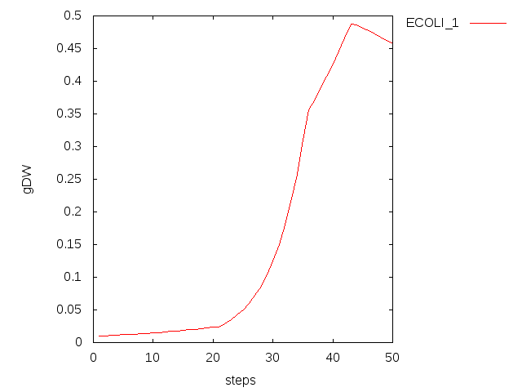
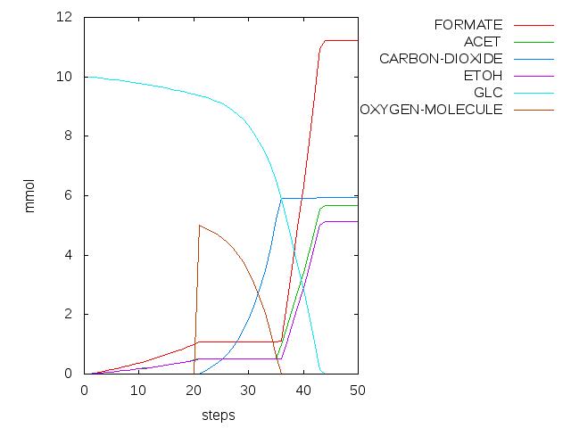
Dynamic FBA Modeling of E. coli
Dynamic FBA modeling of E. coli growth under varying nutrient conditions
t=1-20: E. coli grows anaerobically on 10 mmol glucose
t=21-34: O₂ is added to the simulation; E. coli grows completely aerobically
t=34-35: O₂ availability becomes limiting; acetate forms
t=36-44: O₂ is exhausted; anaerobic growth resumes

Slide 9
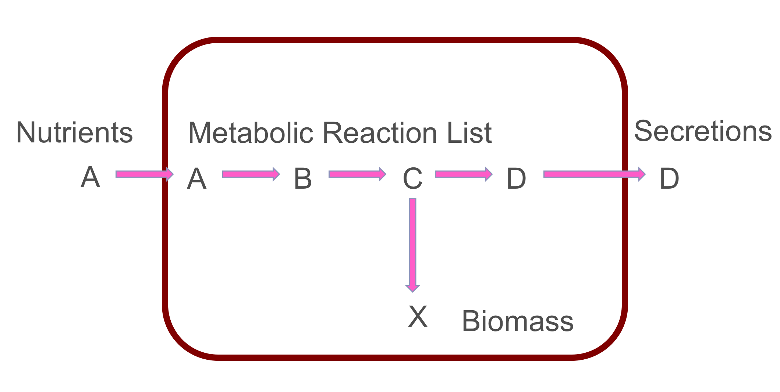

Slide 10
Challenges of Microbiome Metabolic Modeling: Scale
Approaches
Automate model construction
25% of gap-filled reactions are incorrect
Increase accuracy of automated gap filling
Increase speed of manual model building
Spread model building across multiple labs
Plug-and-play metabolic models
Approximate full community with smaller number of models

Slide 11
Challenges of Microbiome Metabolic Modeling: Organism Interactions
Nutrients
Cofactors
Peptides
Stress relievers (e.g., oxidative)
Siderophores
Antibiotics

Slide 12
Metabolic Modeling in Pathway Tools: Collaborative Development / Reuse of Models
Enhance model understandability and accessibility
Web query and visualization tools
Run models through the web
Couple models with enriching information
Pathways, genome, chemical structures, regulatory network
Comments, citations, evidence codes
Collaborative model development
Concurrent multi-user updating of PGDBs
Transaction history stored for PGDBs
Editing tools: reaction editor, pathway editor, Marvin
Share PGDBs via PGDB registry -- http://biocyc.org/registry.html
Plug-and-play models
All PGDBs share reaction and metabolite identifiers with MetaCyc
All PGDBs share common identifiers for cellular compartments

Slide 13
MetaFlux Modeling Tool: Modes of Operation
Solving mode
Individual organisms, organism communities
Steady-state FBA, dynamic FBA
Single compartment, 2-D spatial grid with diffusion
Knock-out mode (single/double gene/reaction knock-outs)
Model development mode
Development mode (multiple gap filling)
Fast Development mode (reaction gap filling) [Latendresse 2014]
Identify dead-end metabolites and blocked reactions
Karp et al, Briefings in Bioinformatics, 2015

Slide 14
Running a Microbiome Simulation
Inputs:
Organism abundances over space and time
Nutrient abundances over space and time
Outputs:
Organism abundances over space and time
Abundances of secreted nutrients over space and time
Several visualization tools available to inspect model results

Slide 15
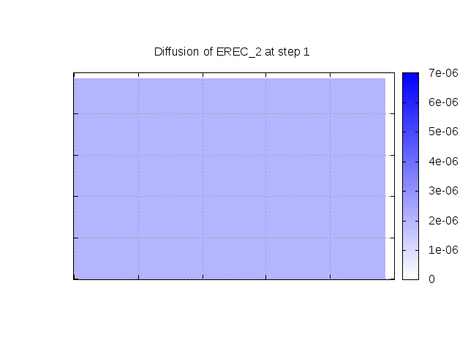
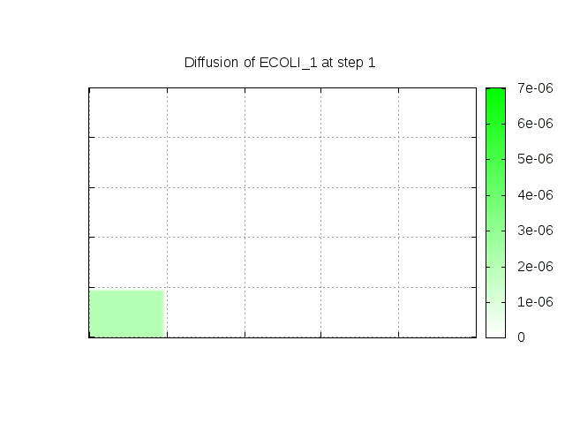
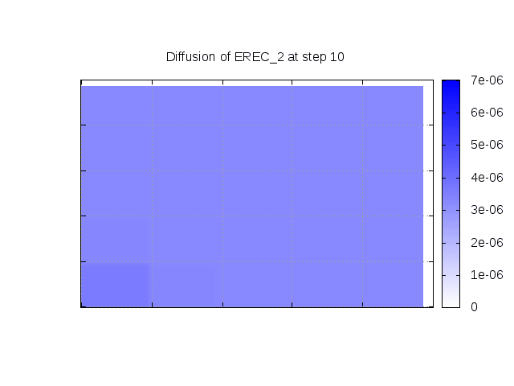
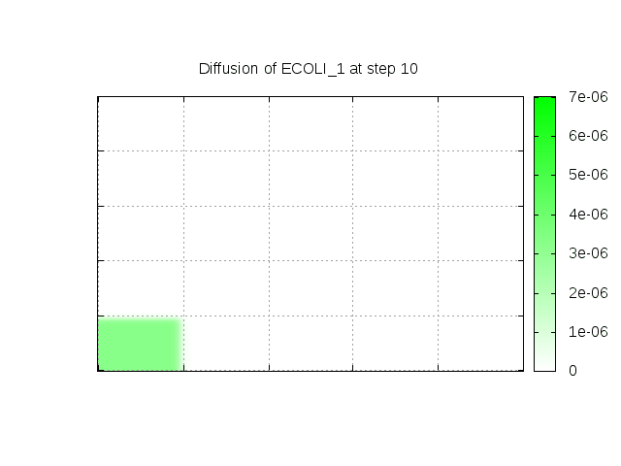
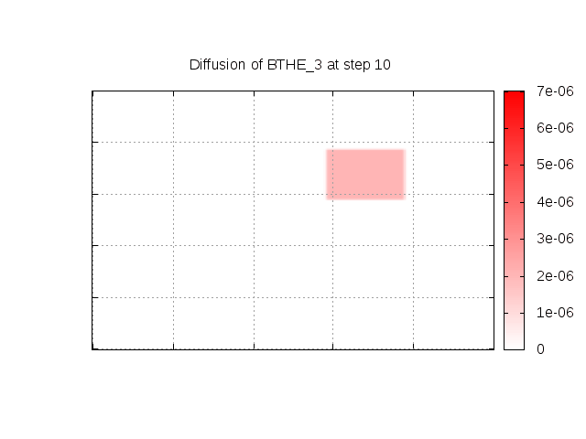
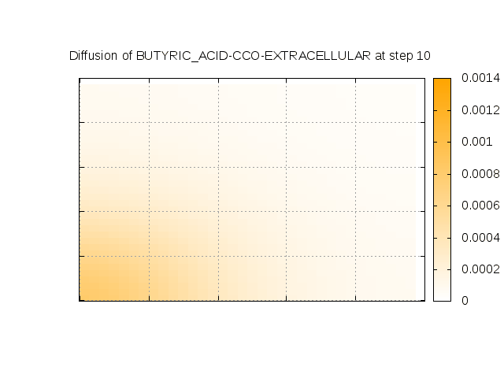
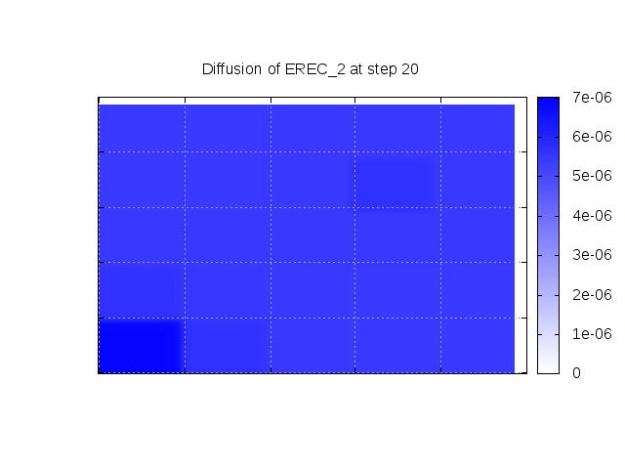
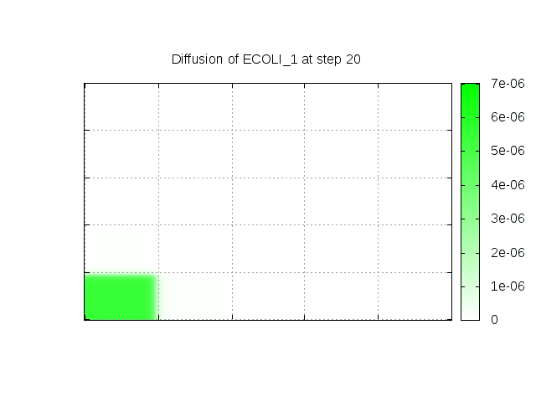
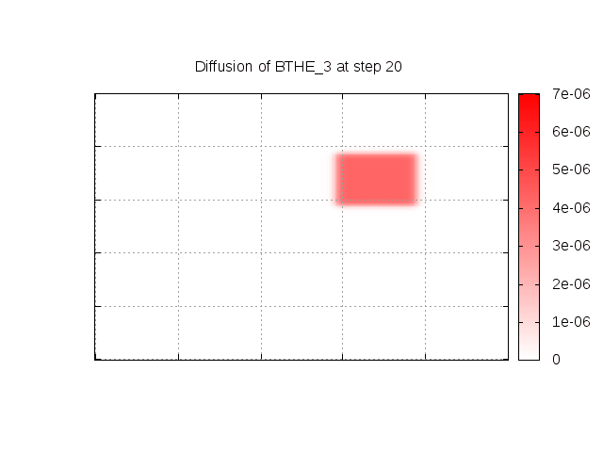
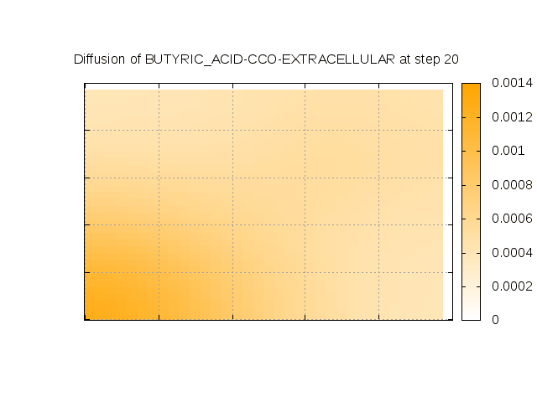
Dynamic Grid Modeling of a Simple Microbial Community
Initially, E. rectale is present throughout the grid; E. coli is present in southwest corner
Halfway through simulation, B. thetaiotamicron is added to the middle of the lawn
E. rectale shows higher growth where E. coli or B. theta are present because of availability of acetate from E. coli. E. rectale produces butyrate where acetate is present.
io
time
Notes:
Dan says:
E rectale produces the butyrate where acetate is present. E coli has been producing acetate since t=0 but B theta has only been producing acetate since t=10 (he thinks there hasn't been enough acetate produced for Erec to produce butyrate)
Consequently E rectale produces more butyrate over by the E coli corner It would probably be better to redo the illustration with a larger grid to more clearly show the different additions of acetate-production bacteria

Slide 16
Curated Models in Hand
Bacteriodes thetaiotamicron
Bifidobacterium longum JCM 1217
Clostridium difficile 630
Escherichia coli
Eubacterium rectale
Contact me to coordinate on creation of additional models
Attend metabolic modeling tutorials at SRI (see BioCyc.org)

Slide 17
Acknowledgements
Wai Kit Ong
Mario Latendresse
Markus Krummenacker
Funding sources:
NIH National Institute of General Medical Sciences
http://www.ai.sri.com/pkarp/talks/
BioCyc webinars:
biocyc.org/webinar.shtml

