Slide 1
Importing and Working with Data from the Metabolomics Workbench
Peter E. Midford ecocyc.org
SRI International biocyc.org
metacyc.org

Slide 2
Overview
What is the Metabolomics Workbench?
Challenges of working with Metabolomics Workbench studies
Importing into Pathway Tools (currently Desktop)

Slide 3
What is the Metabolomics Workbench?
Metabolomics Consortium Data Repository and Coordinating Center
Funded by NIH Common Fund
Repository has 604 released Studies, across 57 species
weighted towards Humans and mammal model organisms
Hundreds more studies under embargo
RefMet is a vocabulary of compounds (and Isobaric mixtures)
11681 identifiers for compounds and isobaric mixtures
Also a structure database and small collection of metabolomics analysis tools

Slide 4
Adding Metabolomics Workbench Import to Pathway Tools
Challenges
Mapping compound identifiers from study data to MetaCyc identifiers
Used MOL files from Workbench Compound Database to generate InChI strings for RefMet terms to match against MetaCyc
Many complex clinical studies
Replicates
Multiple treatment levels/factors
Uses Metabolomics Workbench REST API

Slide 5
Example: Chronic Fatigue Syndrome
Naviaux, et al. Metabolic features of chronic fatigue syndrome. PNAS 2016 September, 113 (37) E5472-E5480.
Metabolite comparison across:
CFS female (n=23)
CFS male (n=22)
No disease female (n=21)
No disease male (n=18)
449 metabolites reported, 131 recognized

Slide 22
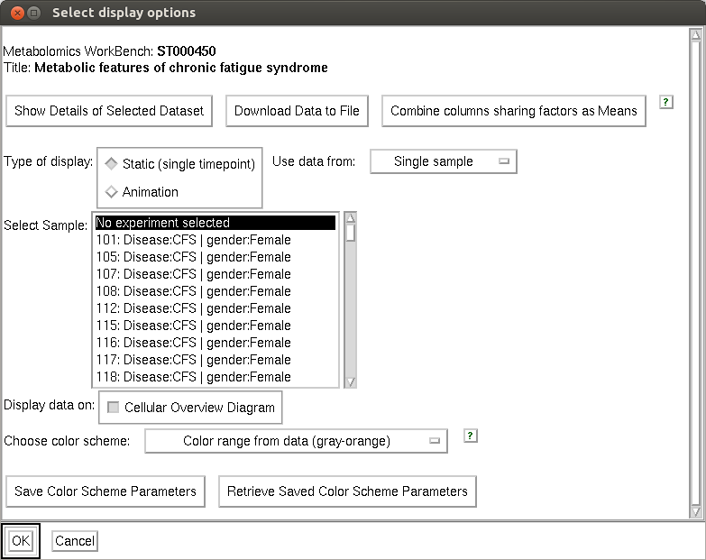
Dashboard?
Current recommendation – save the data file and reload into the Dashboard.

Slide 23
Summary
Metabolomics Workbench includes a growing repository of metabolomics studies
Many of these are human clinical studies with lots of replicates and a wide range of reported compounds, many lacking information about their role in metabolism
Pathway Tools provides several ways to visualize metabolite data extracted from Metabolomics Workbench studies

Slide 24
Acknowledgements
SRI
Peter Karp, Suzanne Paley
Funding sources:
National Cancer Institute

