Slide 1
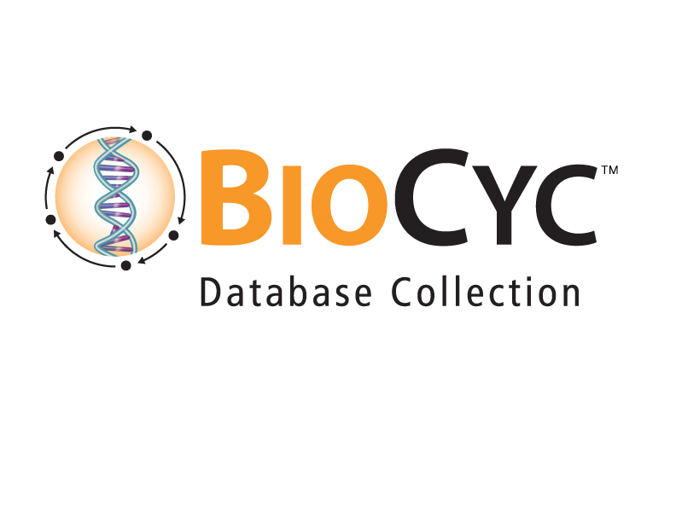
BioCyc Omics Analysis Service
Peter E. Midford ecocyc.org
SRI International biocyc.org
metacyc.org

Slide 2
BioCyc Omics Data Analysis Service
BioCyc Strengths
Visualization
Putting Gene Expression and Metabolite concentrations in context
Challenge: From raw expression data to Analysis using Pathway Tools
Dashboard
Smart Tables
Cellular Overview

Slide 3
Proposed Solution
SRI will provide an analysis service from raw transcriptomics data to cleaned, analyzed results
Results will be presented using both BioCyc and other tools (e.g., R/Bioconductor)
This is not a service for power users, focus is towards wet lab users that want to get data into BioCyc tools.

Slide 4
Initial Analysis Proposal
Initially offer analysis of RNA-seq expression data
Re-format provided data, translate to appropriate identifiers
Data normalization, cleaning, significance calculations using open source tools
E.g. Salmon (or alignment if necessary), DeSeq2, edgeR etc.
Will check for common problems (e.g., batch effects)
Filtered data visualized with appropriate Pathway Tools components:
SmartTable(s) containing expression data
Analyze using Dashboard, Cellular Overview, table of expressed pathways, enrichment analysis
Final report outlining significant results

Slide 5
How can we make this useful to you?
Tools for processing metabolite data
Other gene expression technologies
Other ways of packaging archiving results
Example: save all data and analysis as a (Docker) container
Contribute to your outputs (e.g., publications)

