Slide 1
New BioCyc Search Tools Suzanne Paley Pathway Tools Workshop 2018
Organism Properties
DNA Sites

Slide 2
Source of Organism Properties Data
Parsed from Genome Annotation GenBank File
Imported from NCBI BioSample or other DB
Computed from PGDB
Organism Properties represented in Pathway Tools are a hand-picked subset of MIGS properties – not intended to be comprehensive.

Slide 3
Organism Property Types
Properties of Organism itself
Genome size
Relationship to Oxygen (aerobe, anaerobe, etc)
Temperature Range (mesophile, thermophile, psychrophile)
Properties of Sample
Collection Date, Location
Human Microbiome Body Site
Properties of Database
# Pathways
# GO Terms
# Transcriptional Regulatory Interactions

Slide 5
Constructing Queries
Numbers next to property type and value count organisms w/ data for that property or w/ that value
Select by specific value(s) or any that have value (or the reverse)
Different selection options for numeric, CV, free text properties
Combine multiple constraints w/ AND or OR
Same interface for selecting single organism vs selecting multiple organisms for comparison ops

Slide 6
DNA or mRNA Site Search

Slide 7
Search Options

Slide 8
Example Search

Slide 9
Example Search Results

Slide 10
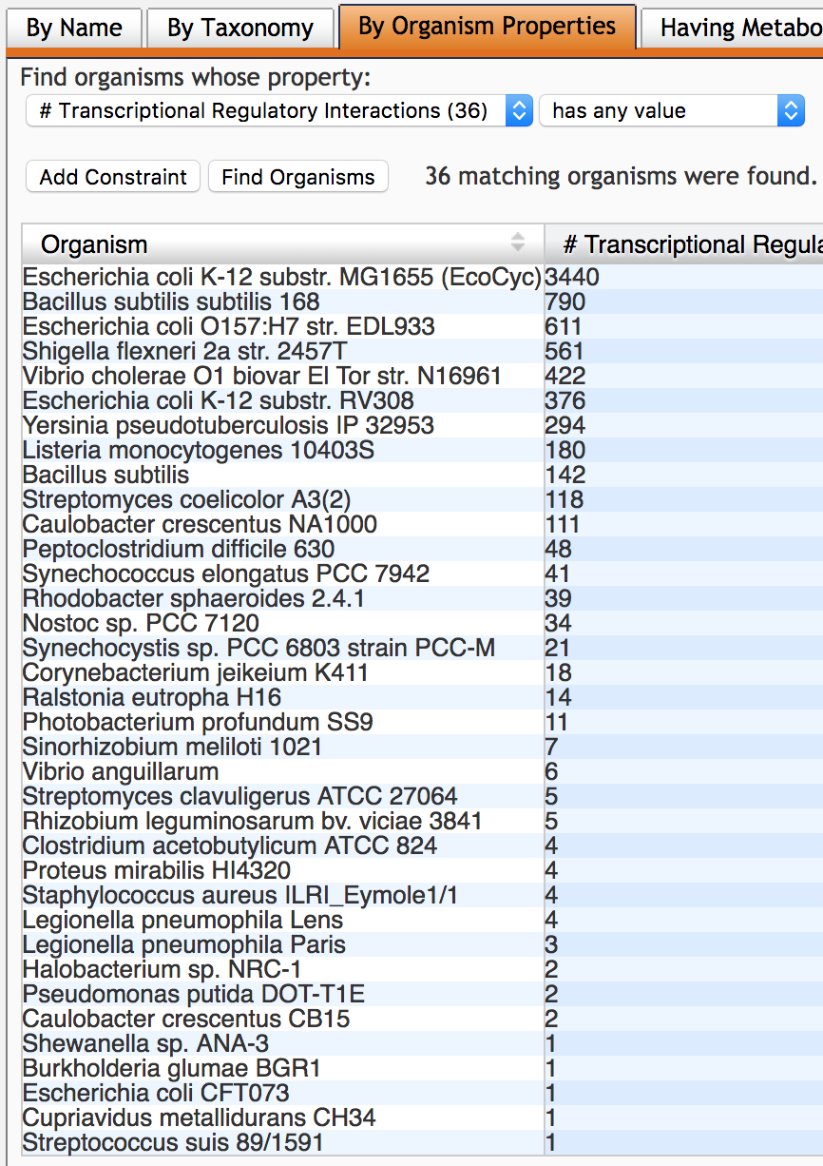
Caveats
Most site types must be curated or imported manually (exception: RegTransBase imports)
For most Tier 3 databases, only available site type will be Transcription-Units

