Slide 1
Characterization of a Rock-Inhabiting Microcolonial (Black) Fungus with the Biolog Restrictions, Solutions, Results
Corrado Nai
March 5th 2013
Corrado Nai
PhD candidate at the Free University of Berlin
BAM Federal Institute of Material Research and Testing
Department 4 (Materials & Environment)
Prof. Dr. Anna A. Gorbushina

Slide 2
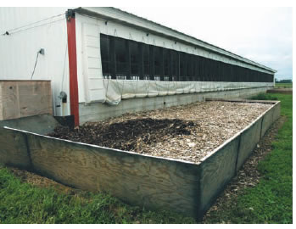
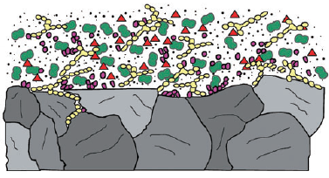
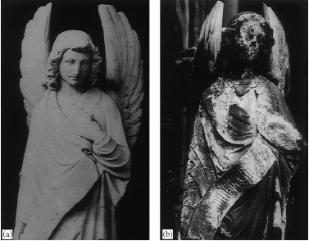
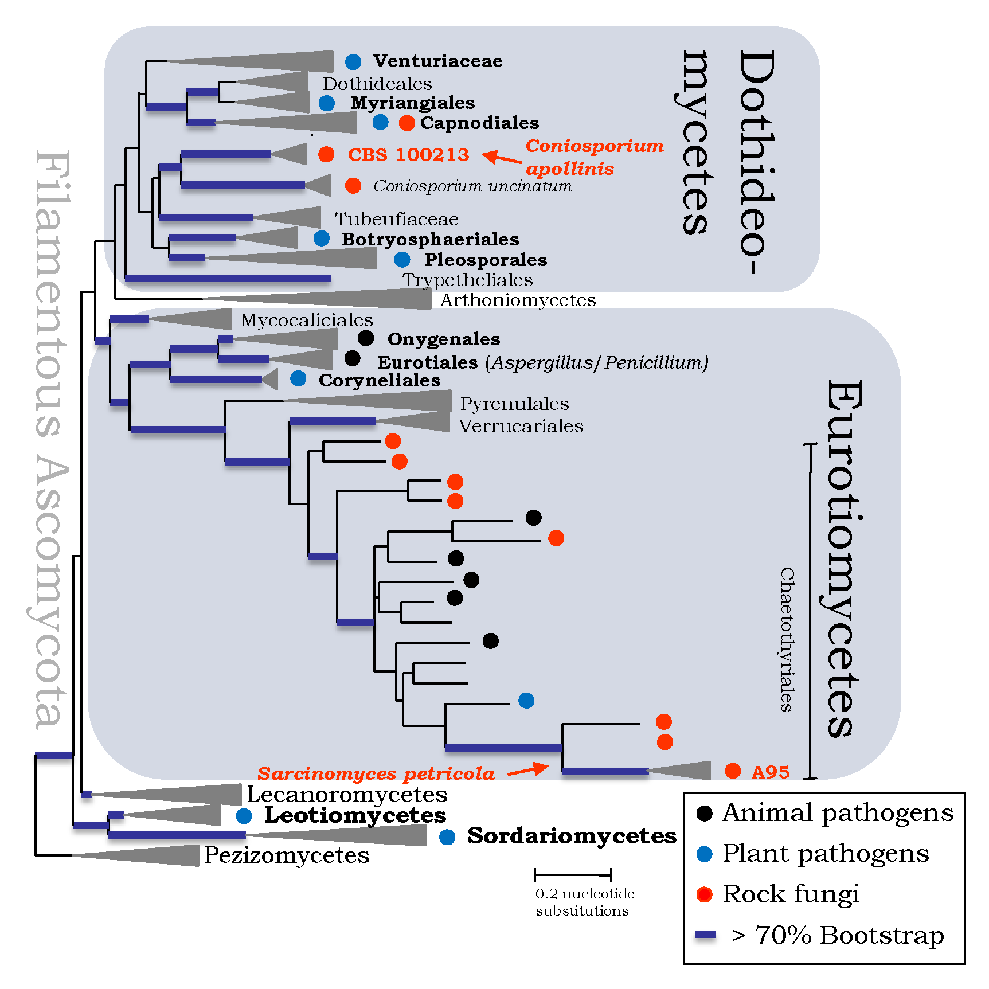
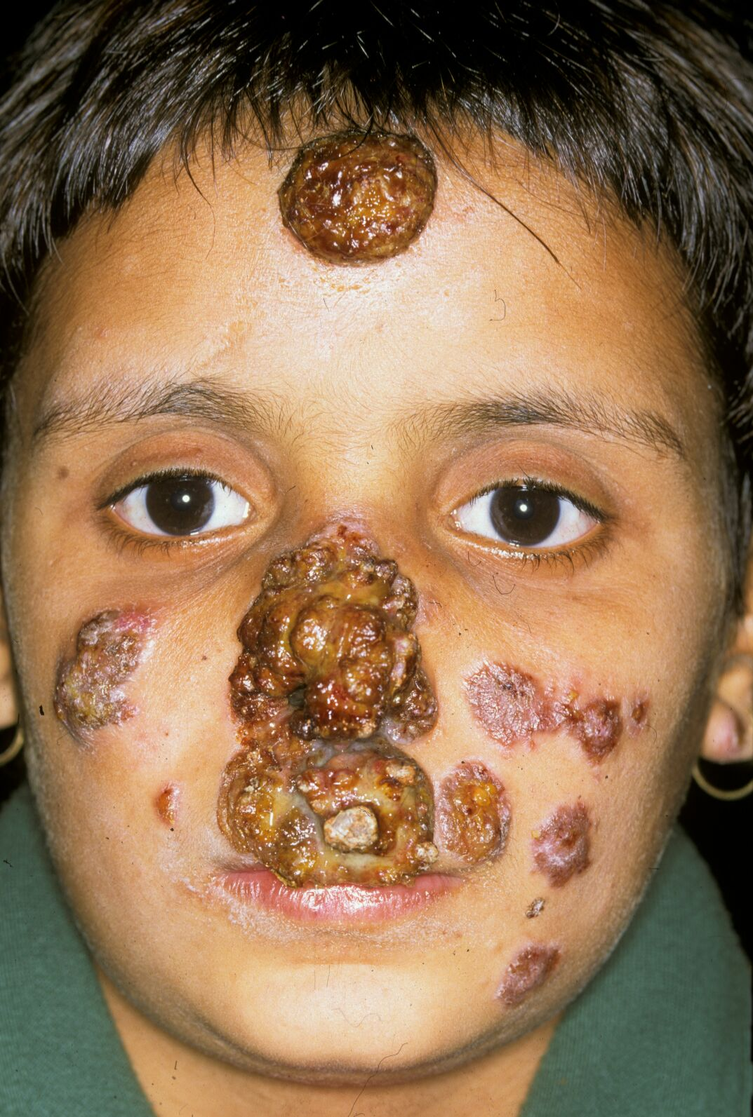
Introduction: Our research (and why it is relevant)
Corrado Nai
March 5th 2013
Extremotolerance
(UV, salinity, oligotrophy, ionizing radiation,…)
Microbial ecology
Gostincar et al. (2010), FEMS Microbiol Ecol
Biofiltration
SABs
Black fungi
(a.k.a. black yeasts, a.k.a. microcolonial fungi, a.k.a. dematiaceous fungi, a.k.a. meristematic fungi)
Krumbein & Jens (1981) Oecologia; Friedmann (1982), Science; Staley et al. (1982), Science
© Sybren de Hoog, CBS-KNAW
Prenafeta-Boldú et al. (2006), FEMS Microbiol Lett
Gorbushina (2007), Environm Microbiol
Fungal genetics
(biodiversity, evolution, phylogenetics)
Material colonization
Fungal pathogenesis
Astrobiology
e.g. Onofri et al. (2008), Stud Mycol
113y
Cologne (Germany)
© Cécile Guiedan
© Sybren de Hoog
CBS-KNAW
Warscheid & Braams (2000), Int Biodet Biodegr
Gueidan et al. (2008), Stud Mycol; Ruibal et al. (2009), Stud Mycol
Black Yeasts Database at the Broad Institute
Notes:
Orders Capnodiales, Dothideales, Pleosporales (class Dothideomycetes), Chaetothyriales (class Eurotiomycetes)

Slide 3
Introduction: Our research (how we contribute)
Corrado Nai
March 5th 2013
Black fungi
(a.k.a. black yeasts, a.k.a. microcolonial fungi, a.k.a. dematiaceous fungi, a.k.a. meristematic fungi)
Knufia petricola A95 (former Sarcinomyces petricola)
+ other black fungi (e.g. Coniosporium apollinis)
A95 + Nostoc punctiforme ATCC29133
A model rock-inhabiting black fungus
(Subaerial-)Biofilm model
Fungal genetics
Extremotolerance
Microbial ecology
Material colonization
(DNA isolation, first-runs of pyrosequencing, generation of cDNA, karyotyping by PFGE)
Collaboration with Dr. Christina Cuomo et al. (Broad Institute)
(mechanisms of oligotrophy, melanin synthesis, secondary metabolites)
(establishment of SABs, interactions with phototrophs, analysis of natural biofilm communities by DGGE)
Dr. Steffi Noack et al.
(colonization of solar panels, simulation of degradation of stone material with flow through-chambers)
Dr. Steffi Noack, Franz Seiffert

Slide 4
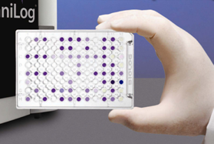
A prerequisite: Knowledge of A95
Corrado Nai
March 5th 2013
Knufia petricola A95
Use of the BiologTM System to generate a broad phenotypical profile of A95
PM1-2 (C metabolism), PM3 (N metabolism), PM4 (P & S metabolism)
PM5 (growth factors, vitamins)
PM9 (salt stress), PM10 (pH)
Total ∼ 1,000 different growth conditions
Support genome annotation
Nutritional requirements
Stress resistance

Slide 5
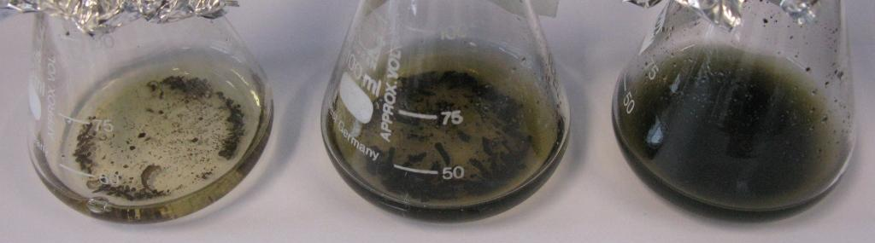
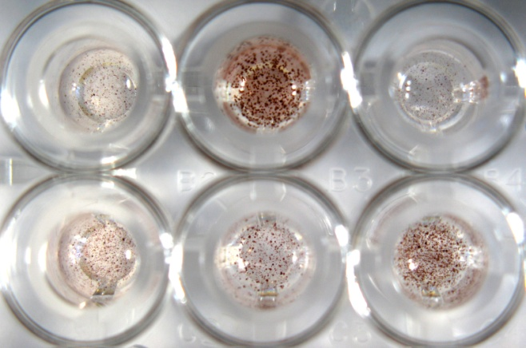
A95 & Biolog System - Restrictions
Corrado Nai
March 5th 2013
1) Clumpy growth → OD measurements not reproducible
2) Association of dye with cell clumps, melanization → dito
3) Extremely oligotrophic → growth in negative control wells (especially without N, P and S)
3 d
8 d
10 d
Redox dye mix E (RME)
-
0.125x
0.25x
0.5x
1x
2x
4x
8x
Pre-experiment: FF-IF pH 5, yeast nitrogen base + 100 mM glc + N source + Redox dye (8 days at 25 °C)
Malt extract media, 25 °C
- N
- P
Growth in PM1 buffered at pH 5 (11 d at 25 °C)
- S
Growth and pink colour development (∼3 wks at 25 °C) in negative control well of:
(A) PM3 (A1, no N)
(B) PM4 (A1, no P) and
(C) PM4 (F1, no S)
(from Nai C et al., in revision)
pH
3.5
4.0
4.5
5.0
5.5
6.0
7.0
Growth in PM10 (7 d at 25 °C)
Notes:
Fig. 6B from Nai et al.: thiophosphate and dithiophosphate (wells B1-2) toxic to A95

Slide 6
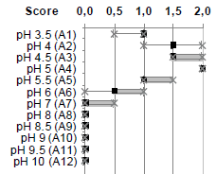
A95 & Biolog System - Solutions
Corrado Nai
March 5th 2013
1) Reduce inoculum and/or incubation time → reduce growth in negative control
2) Grow at suboptimal conditions (e.g. unbuffered plate) → dito
3) Adopt an ad hoc scoring system (evaluation by eye) → semi-quantitative method
at least 2 unbiased (independent) evaluations
at least 3 biological replicates
calculate median and quartiles
0.5-2
0
b
observed growth
no growth
borderline (doubtful growth)
pH
3.5
4.0
4.5
5.0
5.5
6.0
7.0
Score
0.5
1
1.5
2
1.5
1
b
Growth in PM10 (7 d at 25 °C)
Score
control
2
0
no C
L-Ara
GlcNAc
Score
b
1
1-2
… not solved for S metabolism !
D-Ser
Sorbitol
Glycerol
Growth in plate PM1 buffered at pH 5 (11 d at 25 °C)

Slide 7
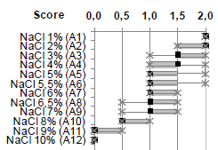
A95 & Biolog System - (Some) Results
Corrado Nai
March 5th 2013
pH optimum at around pH 5 (PM10)
Halotolerant (PM9)
Prototrophic (no special nutritional requirements), but thiamine stimulates growth (PM5)
Good growth on monoaromatic compounds
p-Hydroxybenzoic acid, p-/m-hydroxyphenylacetic acid
Little overlap between sets of nutrient sources
Amino acids/dipeptides: poor C source, preferred N source
Limited ability to grow on metabolic intermediates
e.g. pentose pathway: good growth on L-ara and D-xylose, but not on L-arabitol and xylotol (no uptake)
neg. control
pos. control
thiamine + inosine
thiamine
thiamine pyrophosphate
Growth in PM5 (11 d at 25 °C)
Nai C et al., in revision at Fungal Genetics and Biology
Notes:
Utilization of nutrient: C sources ca. 33%, P sources ca. 51% N sources ca. 75%

Slide 8
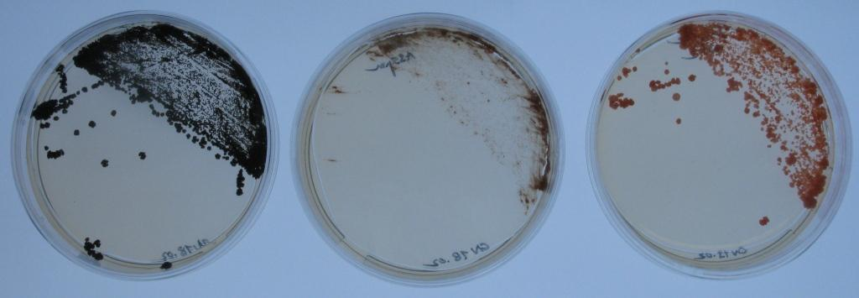
A95 & Biolog System - Outlook
Corrado Nai
March 5th 2013
Further characterization of spontaneous mutants and other black fungi
Coniosporium apollinis CBS100218 (annotated sequence released on 03/2013 by Broad)
Cell wall biosynthesis mutants
Mechanisms of oligotrophy in A95
Sustained growth under nutrient limitation (especially N, P and S)
Test metabolization of hydrocarbons (benzene, toluene, pentane)
p-Hydroxybenzoic acid very good C source
Degradation of cellulose
Cellobiose [glucose β(1→4) glucose] is a good C source
Mutants seem unable to grow on cellulose
Role of trehalose
Trehalose is one of the few very good C sources at suboptimal growth conditions (high pH)
A95 wt
A95 pink mutant (A95pm)
A95pm2

Slide 9
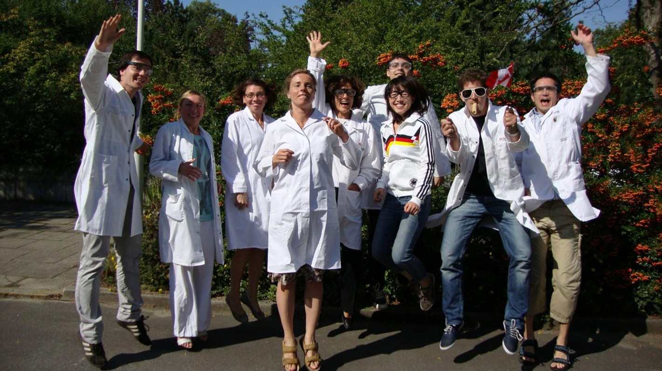
Corrado Nai
March 5th 2013
Questions?
Thank you for your attention !

