Slide 1
Utilization of the Biolog Platform to Understand Neurodevelopmental Disorders Luigi Boccuto, MD JC Self Research Institute Greenwood Genetic Center

Slide 2
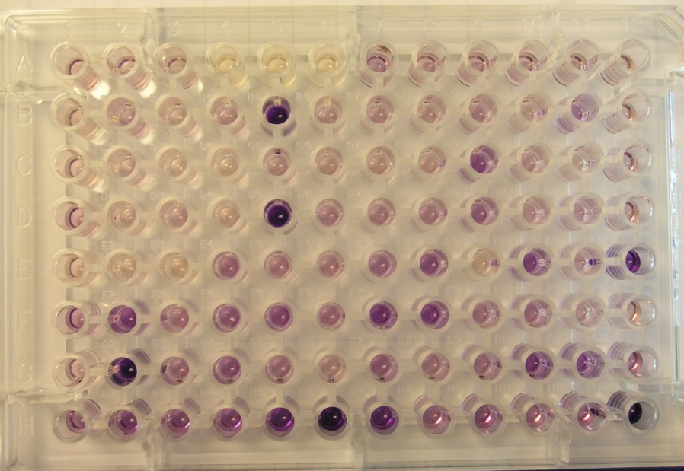
BIOLOG PLATES
96-well plates
50 μl/well of cell suspension (20,000 cells/well)
Incubate 40-48 hours, add Redox Dye Mix (tetrazolium) and incubate for 24 hours
Plate substrates:
Carbon energy sources (sugars, polysaccharides, nucleotides, and carboxylic acids)
2-4. Amino acids and dipeptides
5. Ions
6-8. Hormones and metabolic effectors

Slide 3
BIOLOG studies (in bold significant results)
XLID (60 cases)
MED12 (3 FG and 1 Lujan)
UPF3B (3)
SMS (8)
FMR1 (8+4, no ASDs)
ACSL4 (1)
SLC6A8 (1)
SLC9A6 (1)
MECP2-L1CAM dup (2)
ZNF711 (1)
ATRX (1)
RSK2 (1)
FGD1 (14)
L1CAM (1)
MCT8 (1)
ASDs (151 cases)
NLGN4 (2)
SHANK3 (3)
FMR1 (4)
MECP2 (2)
ZNF711 (1)
Other (128)
Autosomal ID (5 cases)
ZBTB20 (2)
ST3GAL5 (1)
Angelman (2)
Schizophrenia (10 cases)

Slide 4
Autism Spectrum Disorders (ASDs)
ASDs include a series of conditions characterized by delays or abnormal functioning before the age of 3 in one or more of the following domains: social interaction; communication; restricted, repetitive, and stereotyped patterns of behavior, interests, and activities.
The main disorders of the spectrum (DSM-IV-TR) are:
Autistic disorder
Asperger syndrome
Pervasive developmental disorder not otherwise specified (PDD-NOS).
Prevalence: 1/88 (US Center for Disease Control and Prevention, 2012).
ASD research funding in US (2010): $408.5 M, (+84% from 2008).

Slide 5
Significant metabolites in 10 non-syndromic ASD patients vs. 10 controls
 | G1 | G2 | G3 | G4 | G5 | G6 | G7 | G8 | G9 | G10
Substrate | 15627 (NLGN4 A289T) | 16309 (SHANK3 c.1304+48 C>T + microdel 18) | 17702 (NLGN4 S259P) | CMS 13961 (twin) | CMS 13963 (twin) | CMS 17711 | CMS 4613 | 12718 (SHANK3 c.1304+48 C>T + EGR2 SNPs) | 16453 (SHANK3 c.1304+48 C>T) | CMS 6693 (t 14;15) | P value
Trp-Arg | 0.123 | 0.223 | 0.183 | 0.188 | 0.236 | 0.296 | 0.249 | 0.276 | 0.238 | 0.277 | 0.00014
Trp-Glu | 0.133 | 0.277 | 0.203 | 0.225 | 0.271 | 0.323 | 0.317 | 0.437 | 0.251 | 0.29 | 0.00028
L-Tryptophan | 0.215 | 0.378 | 0.305 | 0.303 | 0.377 | 0.293 | 0.44 | 0.344 | 0.394 | 0.447 | 0.00028
Trp-Gly | 0.139 | 0.28 | 0.212 | 0.222 | 0.236 | 0.258 | 0.266 | 0.389 | 0.363 | 0.337 | 0.00042
Trp-Trp | 0.195 | 0.297 | 0.302 | 0.25 | 0.337 | 0.296 | 0.35 | 0.433 | 0.408 | 0.312 | 0.00049
Ala-Trp | 0.179 | 0.269 | 0.219 | 0.24 | 0.311 | 0.326 | 0.325 | 0.319 | 0.288 | 0.333 | 0.00066
Asp-Trp | 0.138 | 0.256 | 0.199 | 0.219 | 0.25 | 0.29 | 0.268 | 0.27 | 0.221 | 0.402 | 0.00071
Phe-Trp | 0.19 | 0.229 | 0.262 | 0.239 | 0.297 | 0.261 | 0.274 | 0.4 | 0.338 | 0.32 | 0.00189
Met-Trp | 0.18 | 0.302 | 0.323 | 0.335 | 0.417 | 0.302 | 0.371 | 0.325 | 0.383 | 0.436 | 0.00210
Glu-Trp | 0.148 | 0.286 | 0.247 | 0.296 | 0.348 | 0.301 | 0.359 | 0.32 | 0.255 | 0.55 | 0.00305
Trp-Asp | 0.124 | 0.257 | 0.171 | 0.197 | 0.273 | 0.346 | 0.245 | 0.396 | 0.259 | 0.28 | 0.00353
Leu-Trp | 0.171 | 0.326 | 0.205 | 0.301 | 0.418 | 0.268 | 0.322 | 0.339 | 0.472 | 0.359 | 0.00459
Trp-Ala | 0.158 | 0.273 | 0.222 | 0.235 | 0.33 | 0.314 | 0.345 | 0.438 | 0.347 | 0.416 | 0.00466
Trp-Tyr | 0.132 | 0.303 | 0.211 | 0.263 | 0.336 | 0.254 | 0.309 | 0.408 | 0.342 | 0.318 | 0.00673
Trp-Val | 0.159 | 0.309 | 0.185 | 0.274 | 0.338 | 0.248 | 0.336 | 0.412 | 0.286 | 0.348 | 0.00804
Ile-Trp | 0.166 | 0.311 | 0.246 | 0.293 | 0.348 | 0.316 | 0.373 | 0.363 | 0.355 | 0.473 | 0.00961
Arg-Trp | 0.127 | 0.181 | 0.14 | 0.169 | 0.218 | 0.342 | 0.205 | 0.249 | 0.345 | 0.27 | 0.01054
Trp-Leu | 0.195 | 0.331 | 0.227 | 0.284 | 0.384 | 0.242 | 0.297 | 0.361 | 0.464 | 0.335 | 0.01984
Lys-Lys | 0.096 | 0.093 | 0.076 | 0.102 | 0.115 | 0.243 | 0.102 | 0.207 | 0.192 | 0.273 | 0.02204
Leu-Ile | 0.167 | 0.116 | 0.081 | 0.207 | 0.266 | 0.408 | 0.234 | 0.306 | 0.371 | 0.403 | 0.02210
Trp-Phe | 0.181 | 0.355 | 0.293 | 0.308 | 0.418 | 0.253 | 0.3 | 0.414 | 0.369 | 0.293 | 0.02273
Ile-Tyr | 0.099 | 0.164 | 0.1 | 0.151 | 0.185 | 0.356 | 0.187 | 0.268 | 0.19 | 0.309 | 0.02423
His-Trp | 0.128 | 0.241 | 0.178 | 0.226 | 0.247 | 0.304 | 0.229 | 0.222 | 0.255 | 0.318 | 0.02525
Gly-Trp | 0.138 | 0.298 | 0.253 | 0.316 | 0.349 | 0.363 | 0.357 | 0.276 | 0.333 | 0.309 | 0.02582
Trp-Ser | 0.166 | 0.317 | 0.232 | 0.255 | 0.298 | 0.226 | 0.323 | 0.372 | 0.398 | 0.311 | 0.02632
a-Keto-Butyric Acid | 0.113 | 0.114 | 0.111 | 0.159 | 0.094 | 0.106 | 0.157 | 0.189 | 0.226 | 0.422 | 0.02740
Mono Methyl Succinate | 1.236 | 1.54 | 2.116 | 1.286 | 1.664 | 0.714 | 1.048 | 1.95 | 1.545 | 1.412 | 0.03126
Ile-Gln | 0.385 | 0.8 | 0.544 | 0.625 | 0.977 | 0.426 | 0.7 | 0.849 | 0.792 | 0.835 | 0.03223
L-Lactic Acid (DL) | 0.464 | 0.572 | 0.867 | 0.666 | 0.922 | 0.706 | 0.318 | 0.588 | 0.823 | 0.797 | 0.03291
D,L-a-Glycerol Phosphate | 0.408 | 0.328 | 0.516 | 0.252 | 0.236 | 0.409 | 0.247 | 0.624 | 0.37 | 0.496 | 0.03566
His-Glu | 0.082 | 0.093 | 0.072 | 0.096 | 0.105 | 0.233 | 0.116 | 0.156 | 0.177 | 0.2 | 0.03605
Tyr-Gly | 0.102 | 0.138 | 0.103 | 0.134 | 0.155 | 0.235 | 0.147 | 0.308 | 0.269 | 0.261 | 0.03918
His-Val | 0.08 | 0.083 | 0.072 | 0.101 | 0.09 | 0.28 | 0.086 | 0.199 | 0.126 | 0.26 | 0.04165
a-Methyl-D-Mannoside | 0.118 | 0.172 | 0.149 | 0.216 | 0.401 | 0.524 | 0.221 | 0.719 | 0.426 | 0.249 | 0.04571

Slide 6
Substrate | Control Average | Green Average | Orange Average | Purple Average | Z Average | P-Value
Glycogen | 1.489 | 1.164 | 1.161 | 0.911 | 1.402 | 0.026949
L-Lactic Acid (DL) | 0.479 | 0.695 | 0.769 | 0.556 | 0.657 | 0.006211
Succinamic Acid | 1.626 | 1.298 | 1.422 | 0.812 | 1.651 | 0.023753
Mono Methyl Succinate | 1.884 | 1.475 | 1.671 | 0.992 | 1.819 | 0.011704
b-Hydroxy-Butyric Acid | 0.359 | 0.529 | 0.557 | 0.379 | 0.412 | 0.023910
Hexanoic Acid | 0.338 | 0.489 | 0.554 | 0.415 | 0.390 | 0.011992
L-Tryptophan | 0.631 | 0.365 | 0.375 | 0.241 | 0.377 | 0.001461
Ala-Arg | 0.194 | 0.273 | 0.314 | 0.222 | 0.211 | 0.018475
Ala-Trp | 0.472 | 0.292 | 0.298 | 0.203 | 0.299 | 0.001675
Arg-Trp | 0.357 | 0.235 | 0.238 | 0.165 | 0.232 | 0.001373
Asp-Trp | 0.449 | 0.264 | 0.314 | 0.166 | 0.242 | 0.001115
Glu-Trp | 0.532 | 0.329 | 0.342 | 0.178 | 0.330 | 0.000942
Gly-Trp | 0.462 | 0.317 | 0.297 | 0.184 | 0.299 | 0.006416
Gly-Tyr | 0.277 | 0.201 | 0.231 | 0.146 | 0.189 | 0.015515
His-Trp | 0.379 | 0.247 | 0.254 | 0.187 | 0.249 | 0.004921
His-Tyr | 0.238 | 0.171 | 0.241 | 0.115 | 0.161 | 0.031716
Ile-Gln | 1.021 | 0.728 | 0.979 | 0.904 | 0.611 | 0.029556
Ile-Trp | 0.538 | 0.342 | 0.397 | 0.278 | 0.324 | 0.006989
Ile-Tyr | 0.331 | 0.212 | 0.313 | 0.216 | 0.209 | 0.018489
Leu-Phe | 0.190 | 0.241 | 0.371 | 0.338 | 0.189 | 0.039625
Leu-Trp | 0.498 | 0.334 | 0.371 | 0.372 | 0.320 | 0.002536
Met-Trp | 0.528 | 0.355 | 0.359 | 0.248 | 0.348 | 0.001670
Met-Tyr | 0.310 | 0.225 | 0.275 | 0.168 | 0.215 | 0.021180
Phe-Trp | 0.395 | 0.291 | 0.337 | 0.203 | 0.288 | 0.000191
Pro-Trp | 0.500 | 0.406 | 0.367 | 0.311 | 0.337 | 0.021670
Ser-Tyr | 0.301 | 0.214 | 0.266 | 0.185 | 0.212 | 0.013745
Trp-Ala | 0.486 | 0.324 | 0.321 | 0.223 | 0.309 | 0.001209
Trp-Arg | 0.402 | 0.241 | 0.290 | 0.158 | 0.231 | 0.000173
Trp-Asp | 0.412 | 0.269 | 0.318 | 0.141 | 0.225 | 0.000740
Trp-Glu | 0.494 | 0.288 | 0.352 | 0.162 | 0.255 | 0.000132
Trp-Gly | 0.472 | 0.285 | 0.317 | 0.190 | 0.268 | 0.000299
Trp-Leu | 0.447 | 0.325 | 0.309 | 0.212 | 0.314 | 0.001800
Trp-Lys | 0.399 | 0.310 | 0.276 | 0.163 | 0.279 | 0.014358
Trp-Phe | 0.420 | 0.334 | 0.312 | 0.231 | 0.295 | 0.000590
Trp-Ser | 0.501 | 0.304 | 0.297 | 0.236 | 0.291 | 0.004266
Trp-Trp | 0.505 | 0.332 | 0.320 | 0.219 | 0.341 | 0.000153
Trp-Tyr | 0.472 | 0.305 | 0.295 | 0.179 | 0.287 | 0.001164
Trp-Val | 0.481 | 0.304 | 0.344 | 0.195 | 0.310 | 0.003150
Tyr-Ala | 0.314 | 0.210 | 0.270 | 0.157 | 0.200 | 0.036694
Tyr-Gly | 0.287 | 0.194 | 0.244 | 0.088 | 0.176 | 0.005801
Tyr-Ile | 0.347 | 0.230 | 0.295 | 0.155 | 0.200 | 0.019385
Tyr-Phe | 0.252 | 0.200 | 0.239 | 0.131 | 0.145 | 0.027475
Tyr-Trp | 0.336 | 0.253 | 0.278 | 0.157 | 0.231 | 0.002382
Tyr-Tyr | 0.328 | 0.233 | 0.225 | 0.124 | 0.185 | 0.003382
Tyr-Val | 0.293 | 0.210 | 0.242 | 0.116 | 0.154 | 0.014950
Val-Gln | 0.731 | 0.499 | 0.615 | 0.543 | 0.380 | 0.022287
Val-Tyr | 0.303 | 0.229 | 0.273 | 0.138 | 0.187 | 0.024195
25/26 (96.1%) Trp (p<0.05)
(only Lys-Trp missing, but it is in acetate salt)
15627 (NLGN4 A289T) | G1
16309 (SHANK3 c.1304+48C>T + microdel 18) | G2
17702 (NLGN4 S259P) | G3
cms13961 (twin) | G4
cms13963 (twin) | G5
cms17711 | G6
cms4613 | G7
12718 (SHANK3 c.1304+48C>T + EGR2 SNPs) | G8
16453 (SHANK3 c.1304+48C>T) | G9
CMS 6693 (t 14;15) | G10
CMS 6276a FMR1 | O1
CMS 9549 FMR1 | O2
CMS 15810 FMR1 | O3
CMS 15811 FMR1 | O4
CMS 1836 (MECP2 R168X) | P1
CMS 3294 (MECP2 M158T) | P2
14071 (ZNF711) | Z1

Slide 7
Trp [E7-F6] Av 20 ctrs | Trp [E7-F6] Av 20 pts | Diff: -22.55%
0.6428375 | 0.497841667

Slide 8
Preliminary microarray data
Expression microarray analysis on 10 ASD patients vs 10 controls showed significantly lower expression of 2 out of 3 genes responsible for the Trp receptors expressed both in blood and brain (SLC7A5 and SLC7A8), the data was confirmed by qPCR
Gene Symbol | P Value
SLC3A2 | 0.25619
SLC7A5 | 0.00627
SLC7A8 | 0.04067
Gene Symbol | P value
AADAT | 0.0022
HAAO | 0.0158
MAOA | 0.0027
TPH2 | 0.0166
The same microarray analysis also showed significant abnormalities in the expression of several enzymes of the Trp-Kynurenine pathway
Data trends for singular Autism patients
AADAT= DOWN 7/10 | QPRT= UP 7/10
MAOA= DOWN 7/10
TDO2= DOWN 5/10 + UP 1/10
HAAO= DOWN 4/10
TPH2= DOWN 4/10
The mitochondrial form of the gene responsible for Trp tRNA was under-expressed, while the cytoplasmic form did not significant differences
Gene Symbol | P value
WARS (cytoplasmic form) | 0.35496095
WARS2 (mitochondrial form) | 0.01599819

Slide 9
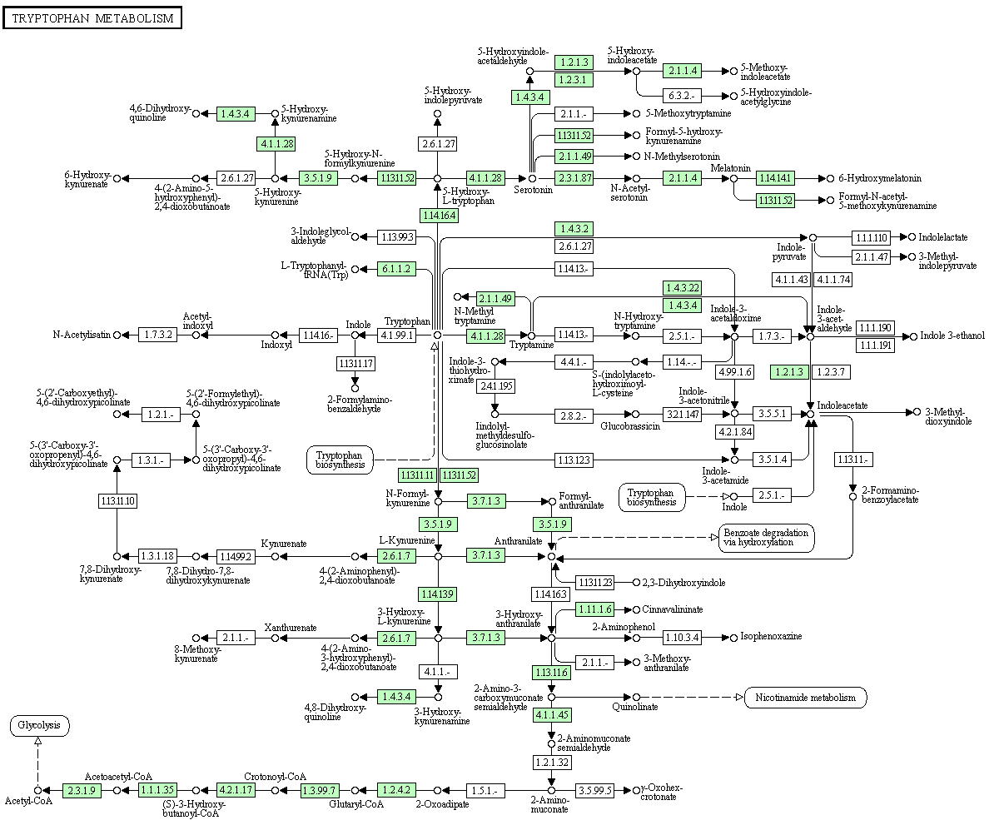
MAOA
MAOA
IDO1/IDO2
IDO1/IDO2
TPH1/TPH2
IDO1/IDO2
WARS/WARS2
MAOA
TDO2
IDO1/IDO2
KYNU
AADAT
KYNU
KMO
AADAT
KYNU
HAAO
QPRT
MAOA
ACMSD
Under-expressed (statistically significant)
Under-expressed (not statistically significant)
Over-expressed (statistically significant)

Slide 10
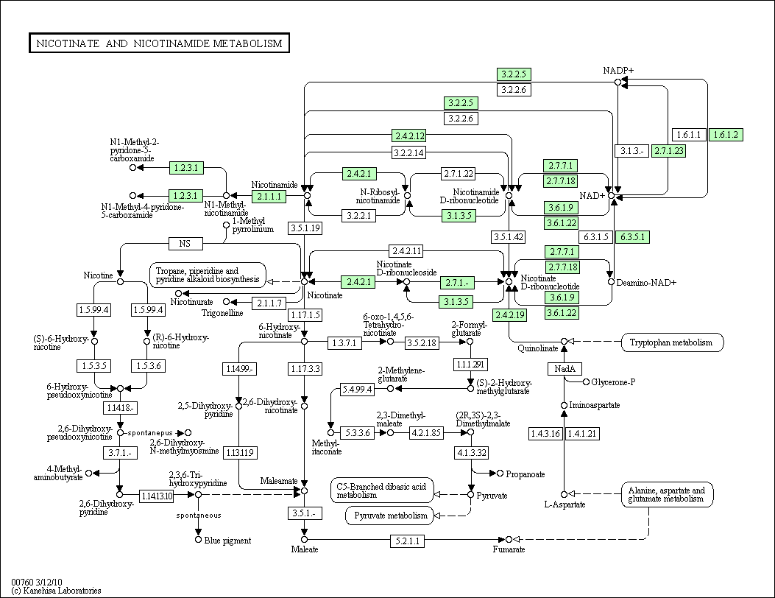
NADSYN1
NMNAT2
ENPP1
NUDT12
QPRT

Slide 11
Background and Hypothesis
Trp->Kynurenine: the balance between kynurenic acid and quinolinic acid (final products of the kynurenine pathway) is critical for neuronal growth, maturation and apoptosis
Quinolinic acid: neurotoxic, induces mitochondrial dysfunction and increases free radical generation, is a potent NMDA agonist, maybe the endogenous ligand during early programmed apoptosis
Kynurenic acid: neuroprotective, NMDA antagonist, and prevents glutamate-induced neuronal death, particularly in the hippocampus
Nitric oxide (NO): influences expression of both molecules, plays a critical role in the interaction between inflammation and neuronal circuits, causes mitochondrial dysfunction, and has been reported elevated in ASD patients

Slide 13
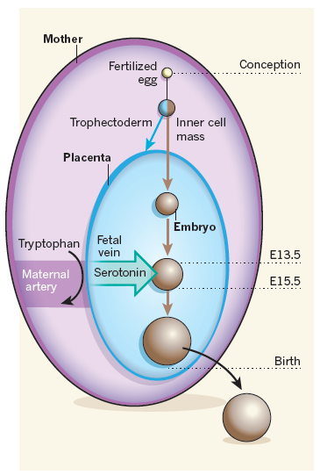
Background and Hypothesis
Trp->Serotonin: Trp depletion can cause abnormal behavior, Serotonin (5-HT) has been associated with mood and behavioral regulation. During the first trimester of gestation, 5-HT is produced by the placenta starting from maternal Trp. This “endogenous” 5-HT is critical in the development of frontal lobes and in the organization of glutamatergic synapses.
from McKay, Nature 2011

Slide 14
Frequency of metabolites that are selected by 7 different feature selection algorithms after testing 17 ASD patients vs. 18 controls
ChiSquared | InfoGain | GainRatioAttribute | SymmetricalUncert | OneRAttribute | RelieFAttribute | SVM
Trp-Ala | Trp-Ala | Trp-Ala | Trp-Ala | Trp-Ala | Trp-Asp | Trp-Ala
Trp-Arg | Trp-Arg | Trp-Arg | Trp-Arg | Trp-Asp | Trp-Gly | Trp-Arg
Trp-Glu | Trp-Glu | Trp-Glu | Trp-Glu | Trp-Gly | Trp-Ser | Trp-Asp
Trp-Gly | Trp-Gly | Trp-Gly | Trp-Gly | Trp-Lys | Trp-Tyr | Trp-Ser
Trp-Leu | Trp-Leu | Trp-Leu | Trp-Leu | Trp-Tyr | Trp-Val | Trp-Trp
Frequency of metabolites that are selected by the 10 different feature selection algorithms after testing 37 ASD patients vs. 20 controls
 | Count | Metabolites | Frequency | Comment
 | 1 | Trp-Gly | 10 | Recommended
 | 2 | Trp-Lys | 8 | Recommended; new on the list
 | 3 | Trp-Ala | 7 | Recommended
 | 4 | Trp-Arg | 7 | Recommended
 | 5 | Trp-Leu | 5 | Recommended
 | 6 | Trp-Phe | 4 | Considered; new on the list

Slide 15
Customized Biolog Tryptophan plate
A1 α-D-Glucose | A2 α-D-Glucose | A3 α-D-Glucose | A4 α-D-Glucose | A5 α-D-Glucose | A6 α-D-Glucose | A7 α-D-Glucose | A8 α-D-Glucose | A9 α-D-Glucose | A10 α-D-Glucose | A11 α-D-Glucose | A12 α-D-Glucose
B1 Empty | B2 Empty | B3 Empty | B4 Empty | B5 Empty | B6 Empty | B7 Empty | B8 Empty | B9 Empty | B10 Empty | B11 Empty | B12 Empty
C1 L-Tryptophan | C2 L-Tryptophan | C3 L-Tryptophan | C4 L-Tryptophan | C5 L-Tryptophan | C6 L-Tryptophan | C7 L-Tryptophan | C8 L-Tryptophan | C9 L-Tryptophan | C10 L-Tryptophan | C11 L-Tryptophan | C12 L-Tryptophan
D1 Trp-Gly | D2 Trp-Gly | D3 Trp-Gly | D4 Trp-Gly | D5 Trp-Gly | D6 Trp-Gly | D7 Trp-Gly | D8 Trp-Gly | D9 Trp-Gly | D10 Trp-Gly | D11 Trp-Gly | D12 Trp-Gly
E1 Trp-Lys | E2 Trp-Lys | E3 Trp-Lys | E4 Trp-Lys | E5 Trp-Lys | E6 Trp-Lys | E7 Trp-Lys | E8 Trp-Lys | E9 Trp-Lys | E10 Trp-Lys | E11 Trp-Lys | E12 Trp-Lys
F1 Trp-Ala | F2 Trp-Ala | F3 Trp-Ala | F4 Trp-Ala | F5 Trp-Ala | F6 Trp-Ala | F7 Trp-Ala | F8 Trp-Ala | F9 Trp-Ala | F10 Trp-Ala | F11 Trp-Ala | F12 Trp-Ala
G1 Trp-Arg | G2 Trp-Arg | G3 Trp-Arg | G4 Trp-Arg | G5 Trp-Arg | G6 Trp-Arg | G7 Trp-Arg | G8 Trp-Arg | G9 Trp-Arg | G10 Trp-Arg | G11 Trp-Arg | G12 Trp-Arg
H1 Trp-Leu | H2 Trp-Leu | H3 Trp-Leu | H4 Trp-Leu | H5 Trp-Leu | H6 Trp-Leu | H7 Trp-Leu | H8 Trp-Leu | H9 Trp-Leu | H10 Trp-Leu | H11 Trp-Leu | H12 Trp-Leu

Slide 17
New customized Biolog tryptophan plate
6 ASDs vs. 6 Controls
Substrate | Aut 15057 | Aut 13669 | Aut 18454 | Aut 15301 | Aut 17160 | Aut CMS 14869 | Control CMS 11237 | Control CMS 11959 | Control CMS 11210 | Control CMS 12225 | Control CMS 12223 | Control CMS 12808 | P value (t test)
a-D-Glucose | 1.755 | 1.259 | 2.182 | 1.815 | 1.124 | 1.436 | 1.596 | 1.817 | 1.743 | 0.916 | 1.549 | 1.247 | 0.6205
Empty | 0.129 | 0.109 | 0.108 | 0.141 | 0.247 | 0.116 | 0.303 | 0.098 | 0.12 | 0.111 | 0.147 | 0.138 | 0.8271
L-Trptophan | 0.384 | 0.259 | 0.37 | 0.443 | 0.555 | 0.513 | 0.67 | 0.564 | 0.651 | 0.696 | 0.949 | 0.627 | 0.0041
Trp-Gly | 0.297 | 0.2 | 0.296 | 0.366 | 0.435 | 0.339 | 0.664 | 0.448 | 0.519 | 0.524 | 0.694 | 0.437 | 0.0028
Trp-Lys | 0.323 | 0.221 | 0.237 | 0.356 | 0.421 | 0.334 | 0.433 | 0.389 | 0.454 | 0.486 | 0.706 | 0.466 | 0.0068
Trp-Ala | 0.359 | 0.234 | 0.289 | 0.398 | 0.434 | 0.361 | 0.441 | 0.457 | 0.543 | 0.542 | 0.716 | 0.56 | 0.0032
Trp-Arg | 0.308 | 0.204 | 0.269 | 0.383 | 0.38 | 0.274 | 0.439 | 0.436 | 0.494 | 0.48 | 0.683 | 0.43 | 0.0024
Trp-Leu | 0.727 | 0.315 | 0.863 | 0.635 | 0.571 | 0.468 | 0.763 | 0.821 | 0.708 | 0.611 | 0.913 | 0.595 | 0.1687
Note: the t test was performed on the log-transformed data.

Slide 18
New customized Biolog tryptophan plate
6 ASDs vs. 6 Controls

Slide 20
New customized Biolog tryptophan plate
10 Schizophrenia patients vs. 2 Controls
Substrate | Schizo CMS 20844 | Schizo CMS 20845 | Schizo CMS 20846 | Schizo CMS 20847 | Schizo CMS 20848 | Schizo CMS 20849 | Schizo CMS 20850 | Schizo CMS 20851 | Schizo CMS 20852 | Schizo CMS 20853 | Control CMS 12225 | p value (Mann-Whitney test) | Control CMS 12223 | p value (Mann-Whitney test)
a-D-Glucose | 2.142 | 1.104 | 1.746 | 1.519 | 1.085 | 0.966 | 1.586 | 2.342 | 2.091 | 1.42 | 0.909 | 0.00195 | 1.268 | 0.10547
Empty | 0.179 | 0.184 | 0.127 | 0.145 | 0.108 | 0.112 | 0.12 | 0.229 | 0.142 | 0.158 | 0.169 | 0.10547 | 0.226 | 0.00391
L-Trptophan | 0.66 | 0.529 | 0.551 | 0.528 | 0.509 | 0.291 | 0.36 | 0.805 | 0.488 | 0.515 | 0.625 | 0.06445 | 0.755 | 0.00391
Trp-Gly | 0.573 | 0.449 | 0.464 | 0.432 | 0.44 | 0.303 | 0.311 | 0.586 | 0.357 | 0.401 | 0.42 | 0.76953 | 0.555 | 0.00977
Trp-Lys | 0.552 | 0.437 | 0.487 | 0.393 | 0.375 | 0.268 | 0.283 | 0.643 | 0.355 | 0.377 | 0.4 | 1 | 0.53 | 0.01953
Trp-Ala | 0.536 | 0.448 | 0.498 | 0.402 | 0.439 | 0.259 | 0.308 | 0.616 | 0.378 | 0.425 | 0.452 | 0.375 | 0.57 | 0.00586
Trp-Arg | 0.549 | 0.399 | 0.426 | 0.362 | 0.329 | 0.21 | 0.249 | 0.688 | 0.37 | 0.424 | 0.405 | 0.55664 | 0.526 | 0.01953
Trp-Leu | 0.624 | 0.512 | 0.59 | 0.497 | 0.498 | 0.421 | 0.451 | 0.796 | 1.034 | 0.504 | 0.553 | 0.92188 | 0.742 | 0.01953
Notes:
Note: The results suggest that Control # 1 is very similar to the Schizo samples while Control #2 is quite different.

Slide 21
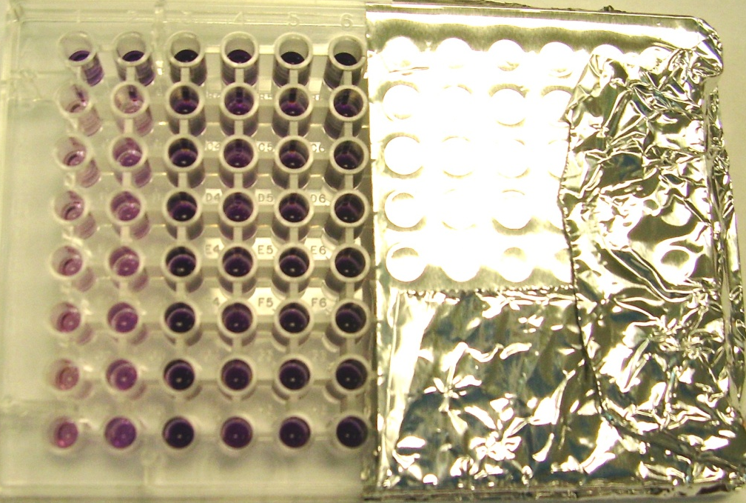
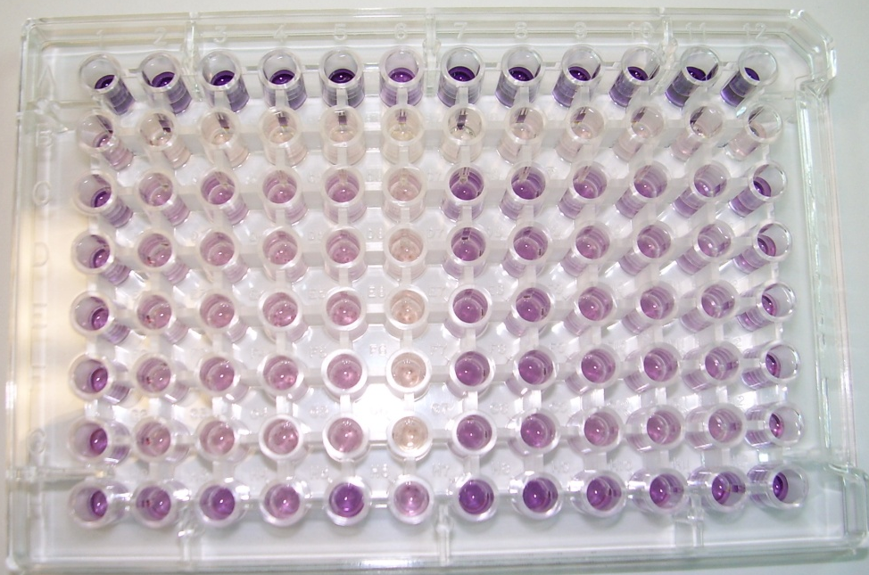

Slide 22
Biolog 50 ASD vs. 50 control cell lines
Substrate | Mann-Whitney P value | Bonferroni correction P value
a-D-Glucose | 0.001344 | 0.010756
Empty | 0.023102 | 0.184815
L-Trptophan | 0.000019 | 0.000148
Trp-Gly | 0.000003 | 0.000024
Trp-Lys | 0.000007 | 0.000059
Trp-Ala | 0.000062 | 0.000495
Trp-Arg | 0.000020 | 0.000163
Trp-Leu | 0.000004 | 0.000030
* P value <0.001, ** P value <0.0001
*
**
**
*
*
**

Slide 23
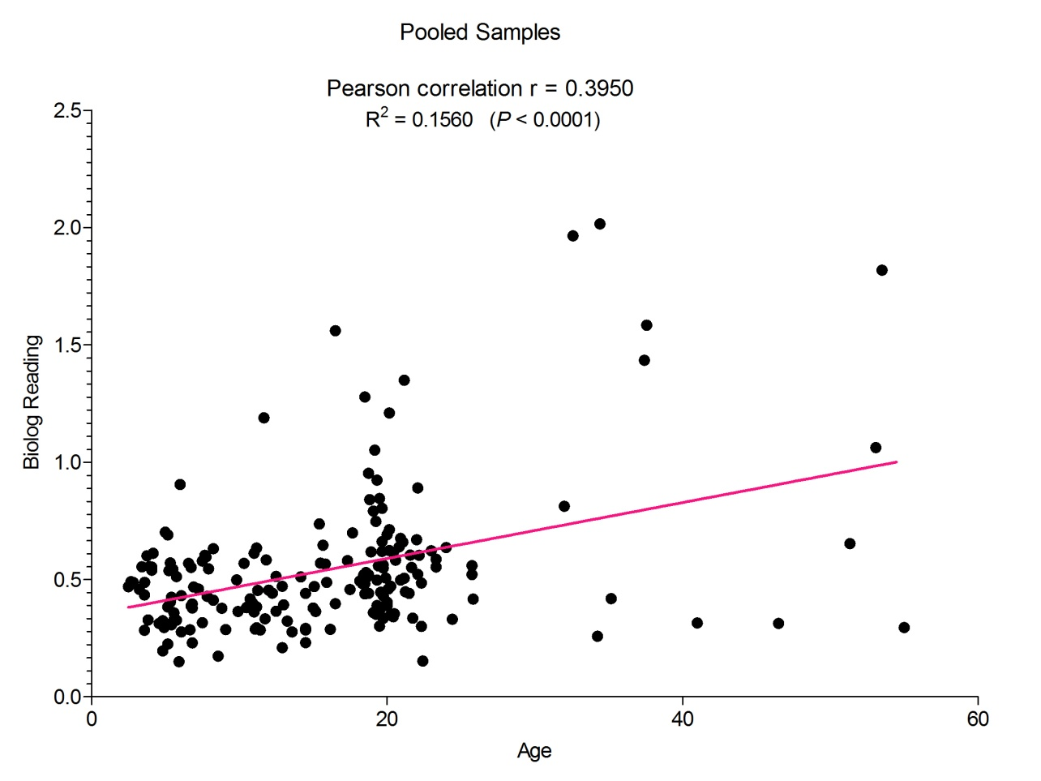
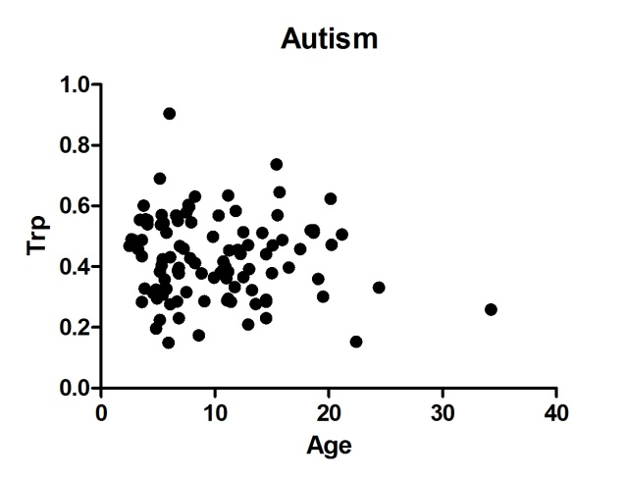
Correlation Analysis of the Trp BioLog Data
Age is not influencing the Trp-NADH findings observed in the Biolog arrays.

Slide 24
Conclusions
NADH generation in the presence of tryptophan as only energy source appears to be significantly lower in lymphoblasts from 87 patients compared to 70 normal controls
This finding was confirmed in both syndromic and non- syndromic cases and is not related to specific genetic alterations
Cell lines from patients with ID and/or behavioral problems, but without autistic traits did not show any difference in NADH production in the presence of tryptophan
Tryptophan metabolites (serotonin, melatonin, kynurenine) have already been linked to behavioral problems and neuronal abnormalities

Slide 25
Biolog customized tryptophan plate – fresh blood 24 h incubation + 24 h dye
Patient 1
Patient 2
Control 1 (4x)
Control 2*
Patient 3*
* Experiment performed in blinded fashion

Slide 26
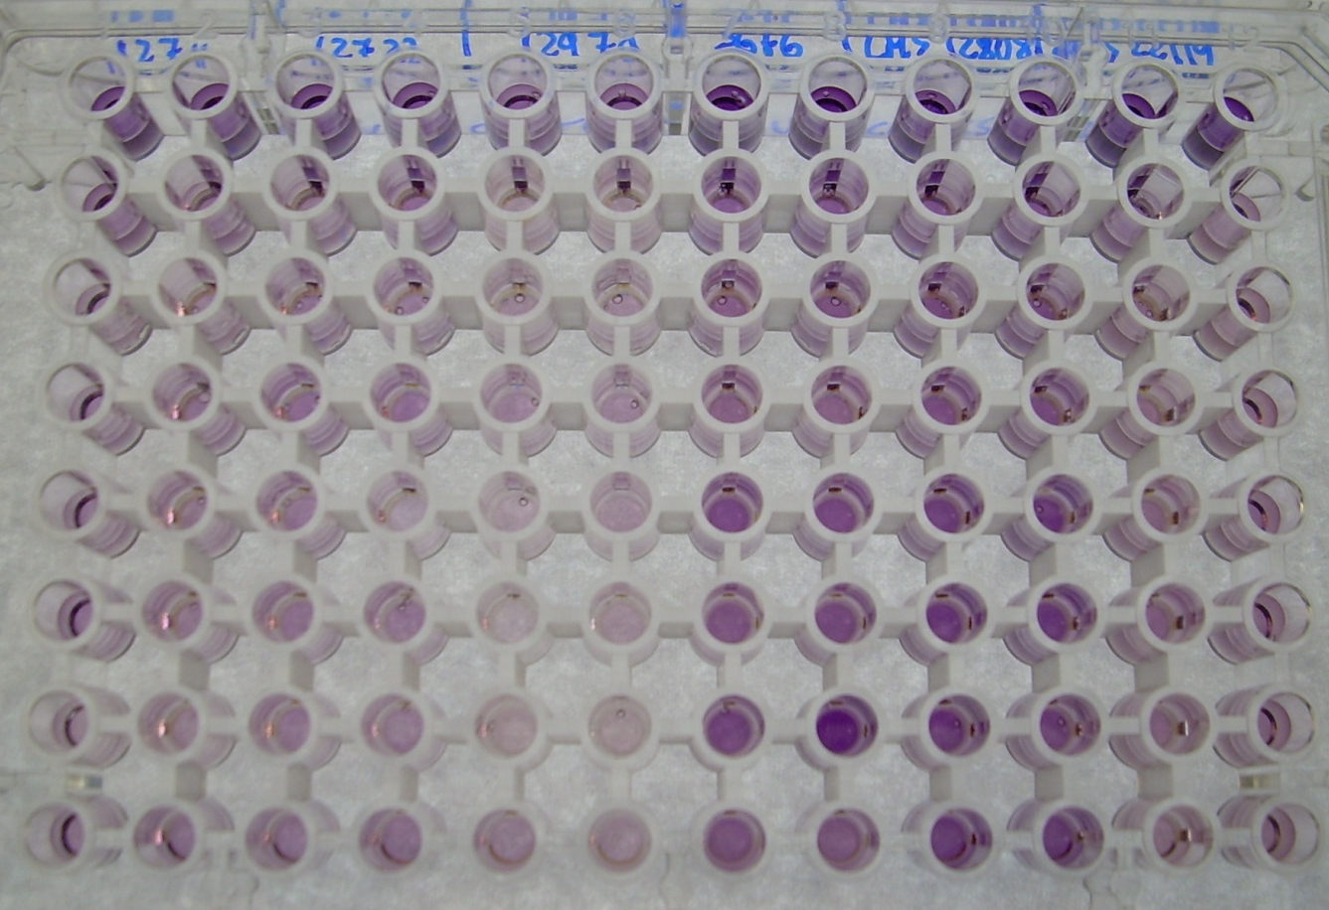
3 SCAP ASD patients vs. 3 controls from previous lymphoblastoid cohort (triplicates)
ASD1
ASD2
ASD3
C1
C2
C3
ASD1
ASD2
ASD3
C1
C2
C3

Slide 27
First 3 ASD patients vs.3 controls (previously tested)
Substrate | C1-1 | C1-2 | C1-3 | C2-1 | C2-2 | C2-3 | C3-1 | C3-2 | C3-3 | Control AVG | ASD1 | ASD2 | ASD3 | P_value ASD1 | P_value ASD2 | P_value ASD3
a-D-Glucose | 1.191 | 1.100 | 0.947 | 0.927 | 0.928 | 0.953 | 2.077 | 1.689 | 1.494 | 1.256 | 0.652 | 0.724 | 0.483 | 0.00391 | 0.00391 | 0.00391
Empty | 0.497 | 0.570 | 0.425 | 0.550 | 0.541 | 0.614 | 0.669 | 0.612 | 0.813 | 0.588 | 0.394 | 0.383 | 0.209 | 0.00391 | 0.00391 | 0.00391
L-Trptophan | 0.512 | 0.550 | 0.492 | 0.568 | 0.567 | 0.542 | 0.742 | 0.776 | 0.451 | 0.578 | 0.254 | 0.282 | 0.212 | 0.00391 | 0.00391 | 0.00391
Trp-Gly | 0.449 | 0.457 | 0.393 | 0.594 | 0.539 | 0.546 | 0.700 | 0.730 | 0.700 | 0.568 | 0.280 | 0.302 | 0.223 | 0.00909 | 0.00909 | 0.00909
Trp-Lys | 0.669 | 0.659 | 0.511 | 0.689 | 0.733 | 0.698 | 0.756 | 0.687 | 0.936 | 0.704 | 0.273 | 0.236 | 0.182 | 0.00391 | 0.00391 | 0.00391
Trp-Ala | 0.501 | 0.575 | 0.617 | 0.747 | 0.703 | 0.684 | 0.799 | 0.894 | 0.994 | 0.724 | 0.283 | 0.273 | 0.148 | 0.00391 | 0.00391 | 0.00391
Trp-Arg | 0.633 | 1.025 | 0.381 | 0.700 | 0.600 | 0.485 | 0.688 | 0.532 | 0.591 | 0.626 | 0.247 | 0.244 | 0.146 | 0.00391 | 0.00391 | 0.00391
Trp-Leu | 0.466 | 0.438 | 0.383 | 0.678 | 0.642 | 0.578 | 0.753 | 0.652 | 0.843 | 0.604 | 0.287 | 0.268 | 0.199 | 0.00391 | 0.00391 | 0.00391

Slide 28
ASD patients vs. controls fresh blood
5 ASD patients vs.6 controls (previously tested)

Slide 29
ASD patients vs. controls fresh blood
12 ASD patients vs.12 controls
(not previously tested as cell lines, blinded fashion)
Substrate | Control Average | ASD 1 | ASD 2 | ASD 3 | ASD 4 | ASD 5 | ASD 6 | ASD 7 | ASD 8 | ASD 9 | ASD 10 | ASD 11 | ASD 12 | ASD Average | P value (Mann-Whitney) | Comment
a-D-Glucose | 2.045 | 0.756 | 0.952 | 0.544 | 2.630 | 1.604 | 2.296 | 1.016 | 1.100 | 0.861 | 2.717 | 2.913 | 1.568 | 1.580 | 0.091871 | Not significant
Empty | 0.498 | 0.035 | 0.559 | 0.372 | 0.264 | 0.263 | 0.426 | 0.214 | 0.284 | 0.088 | 0.303 | 0.487 | 0.108 | 0.283 | 0.001227 | Lower
L-Trptophan | 0.490 | 0.061 | 0.439 | 0.217 | 0.321 | 0.241 | 0.351 | 0.209 | 0.268 | 0.077 | 0.323 | 0.453 | 0.192 | 0.263 | 0.000016 | Lower
Trp-Gly | 0.535 | 0.046 | 0.418 | 0.253 | 0.379 | 0.259 | 0.345 | 0.215 | 0.293 | 0.086 | 0.350 | 0.524 | 0.186 | 0.279 | 0.000038 | Lower
Trp-Lys | 0.588 | 0.051 | 0.561 | 0.376 | 0.392 | 0.288 | 0.446 | 0.126 | 0.323 | 0.393 | 0.359 | 0.598 | 0.262 | 0.348 | 0.000214 | Lower
Trp-Ala | 0.550 | 0.056 | 0.556 | 0.308 | 0.338 | 0.267 | 0.468 | 0.211 | 0.294 | 0.119 | 0.320 | 0.536 | 0.250 | 0.310 | 0.000746 | Lower
Trp-Arg | 0.496 | 0.045 | 0.431 | 0.262 | 0.307 | 0.246 | 0.285 | 0.205 | 0.283 | 0.075 | 0.337 | 0.463 | 0.258 | 0.266 | 0.000038 | Lower
Trp-Leu | 0.499 | 0.063 | 0.531 | 0.296 | 0.332 | 0.242 | 0.411 | 0.207 | 0.293 | 0.095 | 0.320 | 0.459 | 0.291 | 0.295 | 0.000368 | Lower

Slide 30
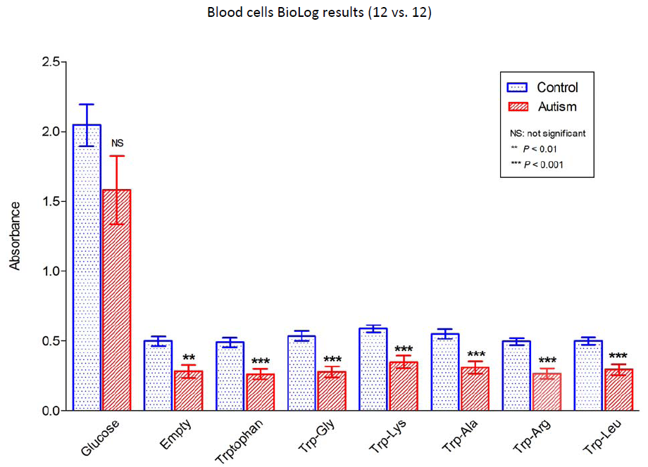

Slide 31
Tryptophan transporters
Transporter | Locus | Linkage to ASDs | Amino acid | Expressed in blood | Expressed in brain
SLC16A10 | 6q21-q22 | No | Aromatic | No | No
SLC7A5 | 16q24.3 | No | Neutral | YES | YES
SLC7A8 | 14q11.2 | No | Neutral | YES | YES
SLC3A2 | 11q13 | Yes (Schellenberg et al Mol Psychiatr 2006) | Neutral | YES | YES
SLC6A19 | 5p15.33 | Yes (Sztamari et al Nat Genet 2007) | Neutral | No | No
SLC6A14 | Xq23-q24 | Yes (Liu et al Am J Hum Genet 2001; Jacquemont et al J Med Genet 2006) | Neutral | No | No
The Trp transport depends on the Large neutral Amino acids Transporter (LAT), a multimeric unit composed by a heavy subunit protein, 4F2hc (SLC3A2), and 2 possible light subunit proteins: CD98 (SLC7A5), that will give LAT1, and the Large neutral amino acids transporter small subunit 2 (SLC7A8), that will give LAT2.

Slide 32
SLC3A2 variants (107 ASD patients)
Patient | Variant | Effect/ Bioinformatics | Parents/controls | SNP (1000 genomes/NHLBI)
17550 (BM) | c.6 G>A (Exon 1) | p.Glu2Glu; 4 new ESEs; no qPCR changes | Mother: negative; 2/274 (0.7%) controls vs 1/107 patients (0.9%) | rs114958414 G: 2183 (99.96%); A: 1 (0.04%) NHLBI G: 12994 (99.96%); A: 6 (0.04%)
12382 (WM)¹ | c.826 G>A (Exon 5) | p.Asp276Asn Benign | Father; 0/281 controls | rs80190679 (G: 99.9%; A: 0.1%) NHLBI G: 12981 (99.9%); A: 17 (0.1%)
 | c.902-24 T>A (Intron 5) | None | Negative (de novo) | No
18454 (BM) ² | c.1027 G>T (Exon 7) | p.Asp343Tyr Deleterious (6/8 websites)-Splice changes | No parents available; 0/542 controls vs. 1/107 patients (0.9%) | No
17410 (WM) ³ | c.1352 G>A (Exon 10) | p.Arg451Gln Deleterious (5/8 websites) | Father (affected brother: Negative) | rs148443520 G: 10755 (99.97%); A: 3 (0.03%) NHLBI G: 12995 (99.98%); A: 3 (0.02%)
17843 (WM) | c.1316 G>T (Exon 10) | p.Arg439Met - Borderline (4/8 websites) | Father (mother not available) | rs116829615 (G: 99.7%; T: 0.3%) NHLBI G: 12979 (99.9%); T: 19 (0.1%)
15294 (BF) | c.594 T>G (Exon 4) | p.Ala198Ala | Not tested | No
17226 ⁴ - 9754 - 18454 ² (BM) | c.1606 C>T (Exon 12) | p.Leu536Leu | 17226: mother and unaffected twin sister= Negative | rs76688902 (C: 98.1%; T: 1.9%) NHLBIG (C: 97.5%; T: 2.5%)
17817-14037-12970 -12053 (BM) | c.902-11 C>T (Intron 5) | Higher Signal Quantile (69->78) at Acceptor Splice Site | 12970: both parents are heterozygous | rs59762129 (C: 95.5%; T: 4.5%)
¹ del (20)(p11.22;p11.23), ² EGR2 SNPs, ³ MET pol C/C, ⁴ FRAXE 0 repeats

Slide 33
SLC7A5 variants (107 ASD patients)
Patient | Variant | Effect/Bioinformatics | Parents/controls | SNP (1000 genomes/NHLBI)
10471 (HM)¹ | c.1123 C>A (Exon 7) | p.Pro375Thr – Deleterious | Mother and relatives: negative; 0/542 controls vs. 1/57 patients (1.75%), p value: 0.0952 | No
 | c.1347 C>G (Exon 9) | p.Val449Val |  | rs11541881 C: 2166 (99.2%); G: 18 (0.8%) NHLBI C: 12969 (99.98%); G: 3 (0.02%)
CMS 14985 (WM-PDD) | c.1141-98 T>A (Intron 7) | Acceptor splice site changes | No parents available | No
15301 (BM) | c.1290+44 G>A (Intron 8) | Lost 1 ESE | Mother: negative | No
CMS 15811 (WM)² | c.816-18 C>T (Intron 4) | Higher Signal Quantile (57 -> 59) at Acceptor Splice Site | No parents available | No
14988 (BM) | c.1141-93 C>T (Intron 7) | None | Not tested | No
4 patients (1 Hom) | c.690 C>G (Exon 3) | p.Asn230Lys Lost 2 ESEs | Father (12970); 10/282 controls (3.5%) | rs1060250 (C: 98.7%, G: 1.3%) NHLBI C: 12768 (98.3%); G: 228 (1.7%)
12970 (BM) ³ | c.387 C>T (Exon 1) | p.Ala129Ala | Father | rs33913122 (C: 99.8%, T: 0.2%) NHLBI (12966) C: 99.97%, T: 0.03%
12 patients, 11.2% | c.843 C>T (Exon 5) | p.Ser281Ser | Not tested | rs33992288 (C: 99.8%; T: 0.2%) NHLBI (12994) C: 99.95%, T: 0.5%
9754 (BM) | c.939+20 C>T (Intron 5) | None | Not tested | rs33993343 (C: 99.8%; T: 0.2%)
9754-14988 (BM) | c.1008 C>T (Exon 6) | p.Phe336Phe | Not tested | rs1060251 (C: 99.2%; T: 0.8%) NHLBI (12996) C: 98.9%, T: 1.1%
12388 (BF)-17226 (BM)⁴ | c.1043+6 C>T (Int 6) | Higher Splice Score (10.1 -> 12.2) at Donor Splice Site | Not tested | rs33966404 (C: 98%; T: 2%)
¹ ZNF711 mut; ² FMR1 full mutation; ³ 47,XY +del(15)(q14); ⁴ FRAXE 0 repeats

Slide 34
SLC7A8 variants (107 ASD patients)
Patient | Variant | Effect/Bioinformatics | Parents/controls | SNP (1000 genomes/NHLBI)
12388 (BF) | c.47 C>G (Exon 1) | p.Pro16Arg – Borderline (4/8 websites) | Mother and affected brother | rs147920363 C: 2180 (99.8%); G: 4 (0.2%) NHLBI C: 12964 (99.7%); G: 42 (0.3%)
6320 (WM)¹ 17673 (BM) | c.52 G>T (Exon 1) | p.Gly18Trp – Deleterious Decreased Signal Quantile (19->8) at Donor Splice Site | Negative (6320-de novo; 17673-Mother); 2/542 controls vs 1/107 patients (0.36% vs 0.9%,) | rs144958980 G: 2175 (99.6%); T: 9 (0.4%) NHLBI G: 12930 (99.4%); T: 76 (0.6%)
4947 (WM) | c.86 C>T (Exon 1) | p.Ser29Phe – Deleterious (5/9 websites) | No parents available; 2/542 controls vs 1/57 patients (0.36% vs 0.9) | rs149980964 C: 2181 (99.9%); T: 3 (0.1%) NHLBI C: 12970 (99.8%); T: 36 (0.2%)
15318 (WM) ¹ | c.1016-49 T>C (Intron 7) | None | Negative (de novo) | No
CMS 6276 (WM) ² | c.1125 C>T (Exon 9) | p.Thr375Thr | No parents available | rs141169165 (C: 99.9%; T: 0.1%) NHLBI (13006) C: 99.92%, T: 0.08%
CMS 1836 (WF) ³ | c.1113+19 G>A (Intron 8) | None | No parents available | No
23 patients, 21.5% (2 Hom, 1.9%) | c.120 C>T (Exon 1) | p.Ile40Ile, 2 new ESEs | Not tested | rs1884545 (C: 94%; T: 6%) NHLBI (13006) C: 89.6%, T: 10.4%
12713 (WM) | c.634+10 G>T (Intron 4) | 1 new ESE | Father | c.634+10 G>A is SNP rs35329117 (no frequency data, no ESE change)
20 patients, 18.7% (5 Hom, 4.6%) | c.635-83 T>A (Int 4) ⁴ | 1 new ESE | Not tested | rs10151002 (T: 93%; A: 7%). Genotypes (1092): T/T: 87.8%, T/A: 10.4%, A/A: 1.7% NHLBI (13006 alleles) T: 99.992%, A: 0.008% (1)
66 patients (16 Hom) | c.913-13 G>T (Intron 6) | Increased Signal Quantile (42 ->63) at Acceptor Splice Site | Not tested | rs1015089 (G: 65.1%; T: 34.9%)
89 patients, 83.1% (31 Hom, 29%) | c.1170 T>C (Exon 9) | p.Tyr390Tyr, 1 new ESE | Not tested | rs7157021 (T: 33.7%; C: 66.3%) NHLBI (13006): T: 41.3%, C: 58.7%
¹ ZBTB20 mut ; ² FMR1 full mutation ; ³ MECP2 (c.502 C>T; p.R168X); ⁴ T>A genomic, A>T cDNA

Slide 35
Fragile X syndrome
Moderate to severe ID, macroorchidism, and distinct facial features, including long face, large ears, and prominent jaw.
About 1/3 of the patients show autistic traits, other behavioral issues (i.e.: ADD/ADHD, anxiety/OCD) are also common.
First monogenic cause of ID (1/4,000 males).
Unstable expansion of a CGG repeat in the FMR1 promoter and abnormal methylation → suppression of FMR1 transcription and decreased protein levels in the brain.

Slide 36
Preliminary data – Fragile X syndrome
12 cases (8 with full mutation, 4 female carriers) versus 12 controls
Considering just the Fragile X diagnosis, neither the patient nor the carrier cohort showed significant metabolic differences as compared to controls
Two subgroups with mental disorders:
3 cases with ADD/ADHD (and Anxiety/OCD)
6 cases with Anxiety/OCD (including the 3 with ADD/ADHD)
In both subgroups we noticed a statistically significant increase of utilization of glucose-related sugars, Krebs cycle intermediates, and ketone bodies, as compared to controls.

Slide 37
Preliminary data - Fragile X patients with ADD/ADHD and Anxiety/OCD (3)
Significantly increased utilization of:
glucose-related sugars (14/27, 51.8%), particularly glucose*
n-acetyl-neuraminic acid: predominant sialic acid in gangliosides (crucial component of neuronal membranes)
pyrimidines (2/2): thymidine and uridine*
Krebs cycle intermediates (7/9, 77.7%): particularly lactate*, succinate*, and malate*
ketone bodies and other carboxylic acids (9/13, 69.2%): particularly acetoacetate*, b-hydroxy-butyrate*, propionate*, and acetate*
most amino acids: some (Asn*, His*, Met*, and Val*) were significant for all the wells in the arrays.
* Significant in 3/3 cases
Notes:
n-acetyl-neuraminic acid: the predominant sialic acid found in mammalian cells, especially found in gangliosides, a crucial component of neuronal membranes in the brain.

Slide 38
Preliminary data – Fragile X patients with Anxiety/OCD (6)
Significantly increased utilization of:
glucose-related sugars (9/27, 33.3%), particularly glucose*
n-acetyl-neuraminic acid
pyrimidines (2/2): thymidine and uridine*
Krebs cycle intermediates (6/9, 66.7%): particularly lactate* and pyruvate*
ketone bodies and other carboxylic acids (6/13, 43.1%): particularly acetoacetate*, b-hydroxy-butyrate*, and acetate*
Only Asn* was significant for 80% of the wells in the arrays.
* Significant in at least 4/6 cases

Slide 39
Background (ID and ADD/ADHD)
Neuronal cells have one of the highest metabolic rates in the human body and use sugars and ketone bodies as primary energy sources.
Abnormal metabolism of sugars and ketone bodies may affect neuronal development, signal transmission and synaptic function.
Several mental disorders have been associated with increased metabolism within specific brain areas as detected by PET studies.

Slide 40
Hypothesis (ID and ADD/ADHD)
Some mental disorders have a late onset (ADD/ADHD, OCD, Tourette syndrome) and can occur after an event causing an increase in metabolic rate (high fever, infections, brain damages, puberty).
When compared to controls, cells from patients with ID and developmental mental disorders like ADD/ADHD appear to have increased need of energy sources under situations promoting metabolic stress and the consequences can be more severe in those tissues with higher metabolic rates (i.e. neuronal cells).

Slide 41
Summary
Biolog phenotype microarray plates are able to identify significant abnormalities in the metabolic profile of cells from patients with neurodevelopmental disorders, like ASDs, ADD/ADHD, and anxiety/OCD.
The metabolic findings reveal new molecular pathways playing an important role in the pathogenesis of those disorders and can provide new tools for therapeutic approaches.
Follow-up studies involving kinetics and gene expression analysis are ongoing to better characterize these findings.

Slide 42
Acknowledgments
Dr. Charles Schwartz
Dr. Chin-Fu Chen
Cindy Skinner
Kelly Jones
Lauren Cascio
Ayla Pittman
Mackenzie DeGraff
Heather McCartney

